Slide 1
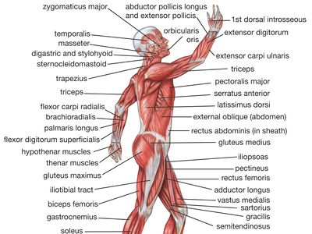
MUSCLE
FACTS

Slide 2
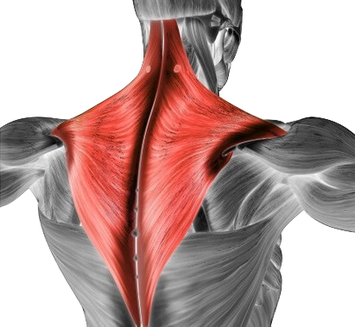
MUSCLE SET 1
TRAPEZIUS

Slide 3
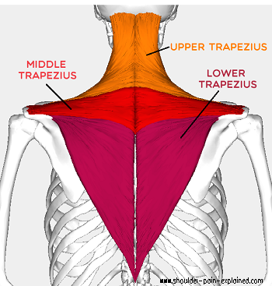
UPPER TRAPEZIUS
O: Occiput - C7
I: Lateral 1/3 of Clavicle, Acromion
Process, Spine of the Scapula
A: Elevation of the Scapula, Upward
Rotation of the Scapula

Slide 4
MIDDLE TRAPEZIUS
O: T1 . . .T5
I: Spine of the Scapula
A: Retraction of the Scapula

Slide 5
LOWER TRAPEZIUS
O: T6 . . .T12
I: Root of the Spine of the Scapula
A: Depression of the Scapula, Upward
Rotation of the Scapula

Slide 6
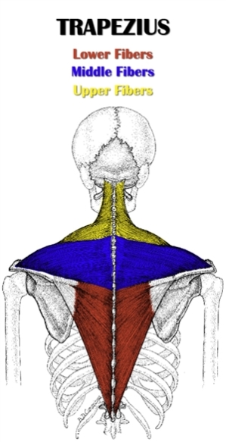

Slide 7
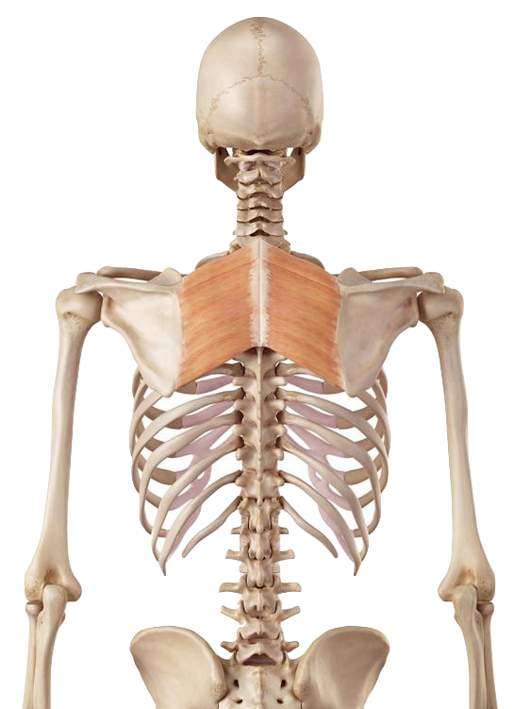
MUSCLE SET 2
RHOMBOIDS
ERECTOR SPINAE

Slide 8
Side Note:
Often Overstretched
RHOMBOIDS
O: C7 . . . T5
I: Medial Border of Scapula
A: Retraction, Downward Rotation, and Elevation of Scapula

Slide 9
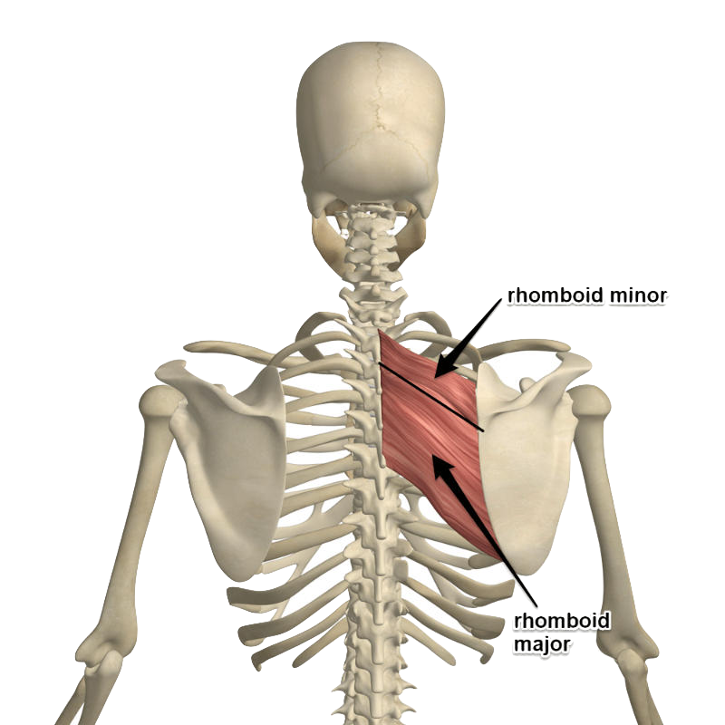
Rhomboids

Slide 10
ERECTOR SPINAE
O: (Inferior Attachment) Sacrum via
the Thoracolumbar Aponeurosis
I: (Superior Attachment) Occiput
A: Extension of Spine (bilateral), Lateral
Flexion of Spine (unilateral)

Slide 11
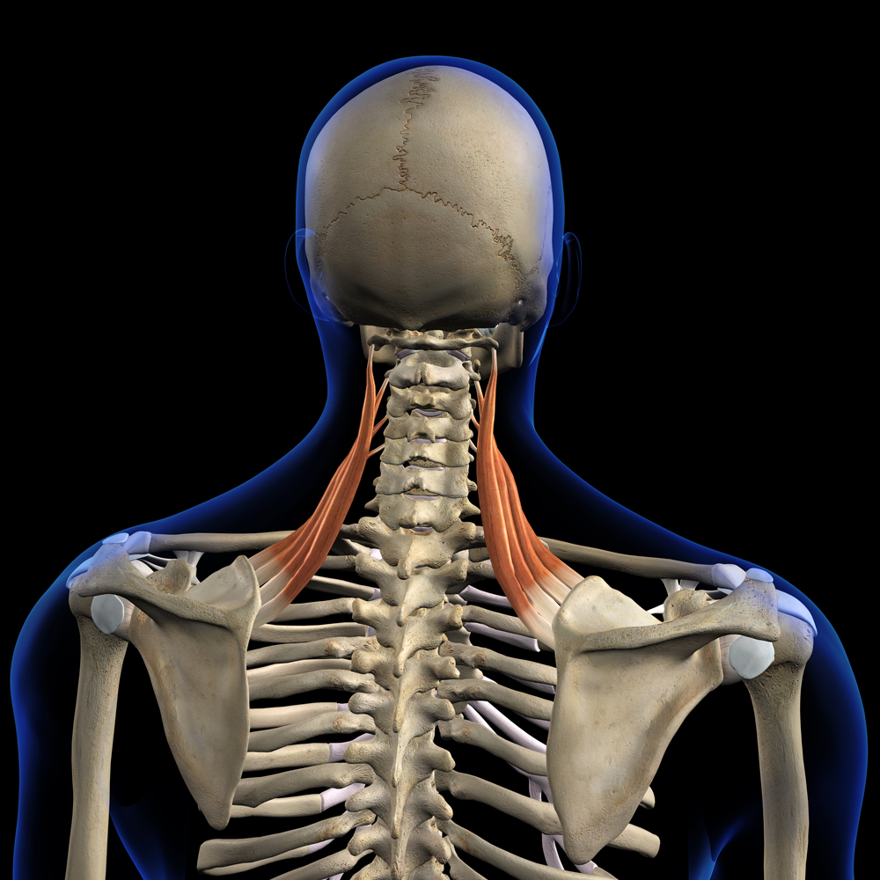
Levator Scapula
Erector
Spinae
Iliocostalis muscle
Longissimus muscle
Spinalis muscle

Slide 12
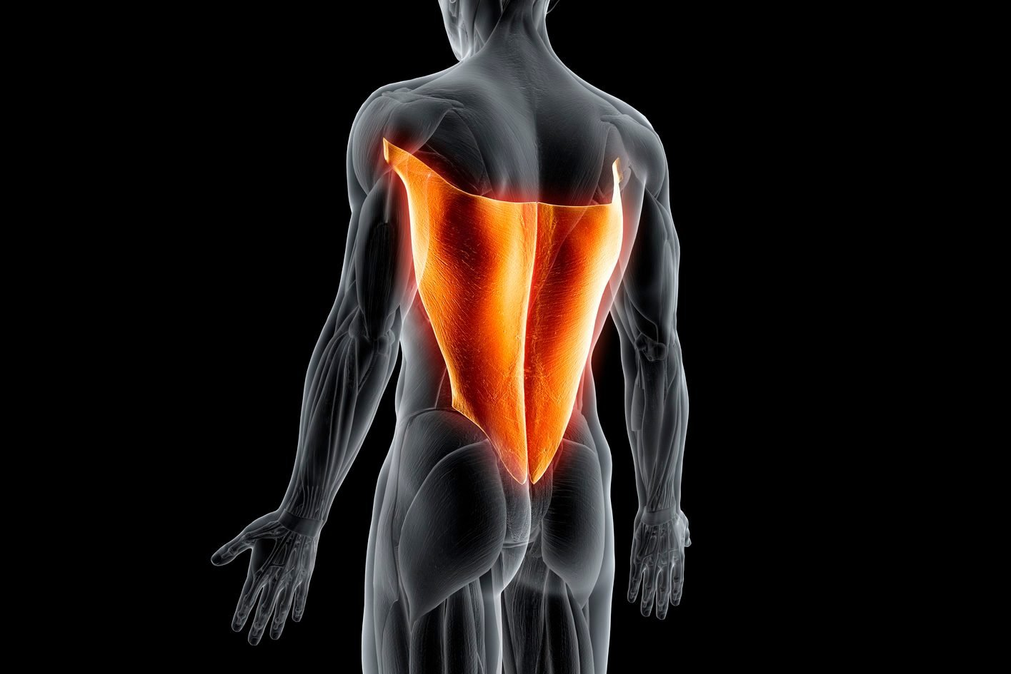
MUSCLE SET 3
LATISSIMUS DORSI
TERES MAJOR
SERRATUS ANTERIOR

Slide 13
LATISSIMUS DORSI
O: Thoracolumbar Aponeurosis
I: Bicipital Groove of the Humerus (medial lip)
A: Adduction of the Humerus, Extension of the Humerus, Medial Rotation of Humerus
Side Note: Broad

Slide 14
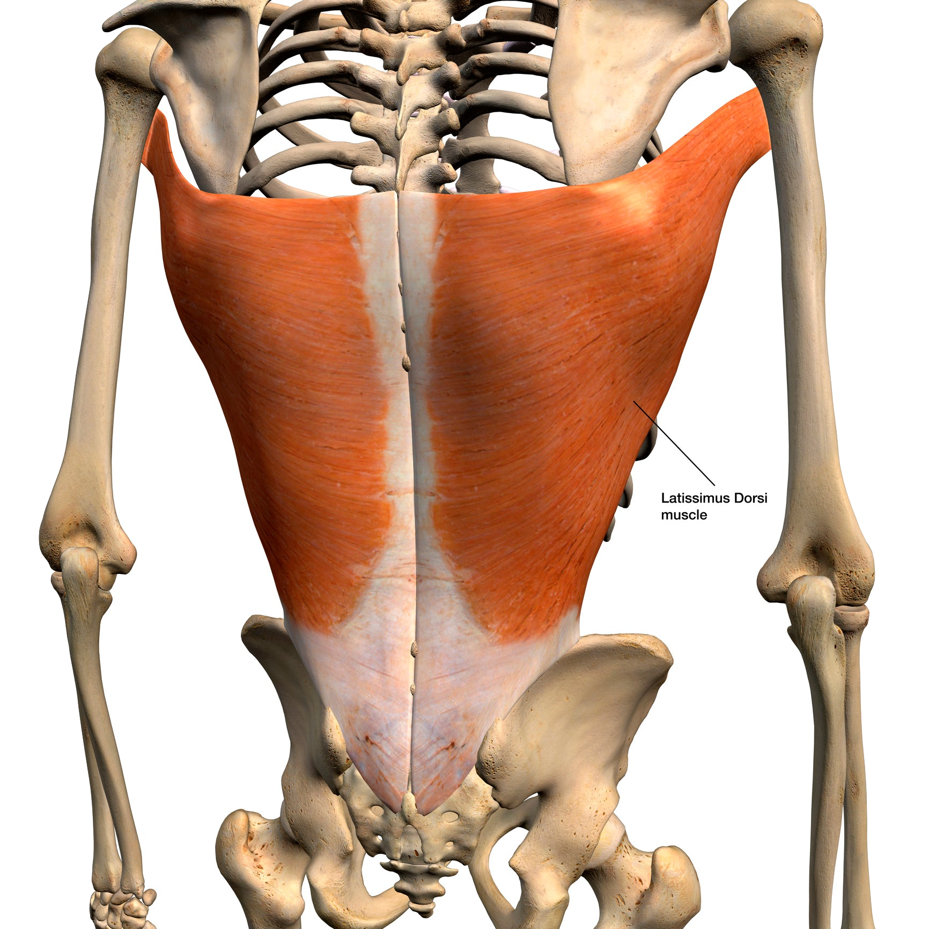
Levator Scapula
Lattisimus
Dorsi

Slide 15
Side Note: Tight
TERES MAJOR
O: Lateral Border of Scapula
I: Bicipital Groove of Humerus (medial lip)
A: Adduction of Humerus, Extension of Humerus, Medial Rotation of Humerus

Slide 16
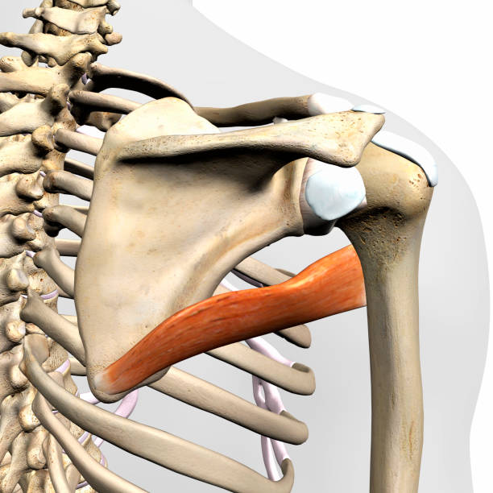
Levator Scapula
Teres
Major

Slide 17
Side Note: Strongest Protraction Muscle; Tight
SERRATUS ANTERIOR
O: First 8 Ribs
I: Medial Border of Scapula (anterior side)
A: Protraction of Scapula

Slide 18
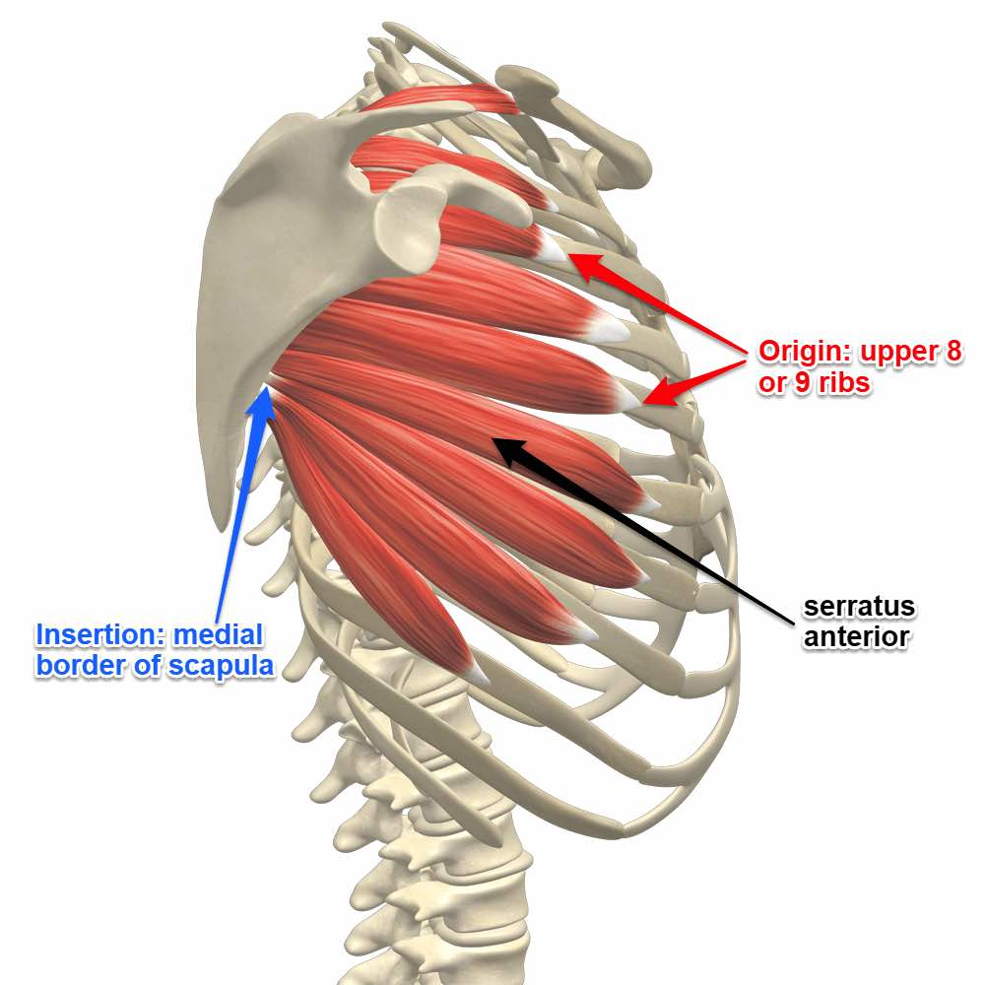
Levator Scapula
Serratus
Anterior

Slide 19
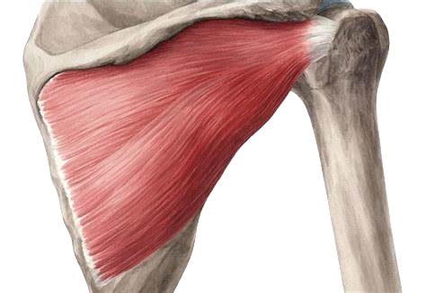
MUSCLE SET 4
Supraspinatus
Infraspinatus
Teres Minor
Subscapularis

Slide 20
SUPRASPINATUS
O: Subscapular Fossa
I: Greater Tubercle of Humerus
A: Abduction of Humerus, stabilizes scapula and humeral head

Slide 21
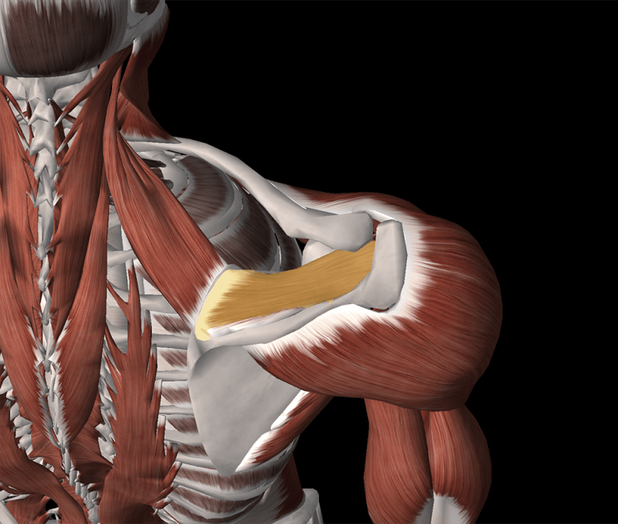
Levater Scapula
Supraspinatus

Slide 22
INFRASPINATUS
O: Infraspinatus Fossa
I: Greater Tubercle of Humerus
A: Lateral Rotation & Extension of Humerus

Slide 23
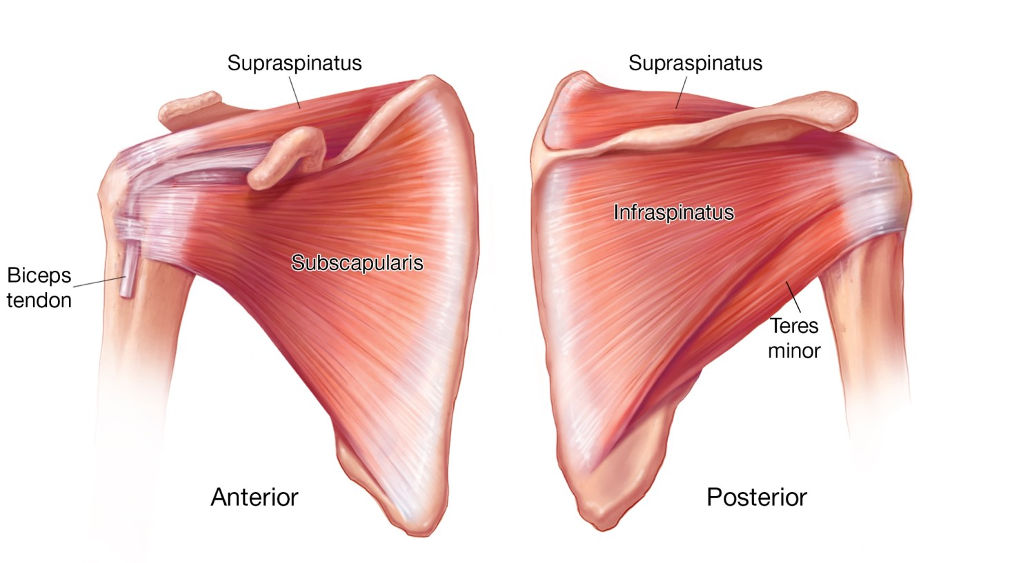
Infraspinatus

Slide 24
TERES MINOR
O: Lateral Border of Scapula
I: Greater Tubercle of Humerus
A: Lateral Rotation & Extension of Humerus

Slide 25
Levator Scapula
Teres Minor

Slide 26
SUBSCAPULARIS
O: Subscapular Fossa
I: Lesser Tubercle
A: Medial Rotation of Humerus

Slide 27
Subscapularis

Slide 28
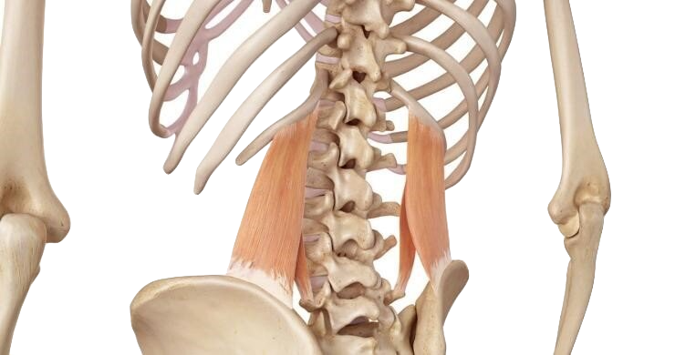
MUSCLS SET 5
QUADRATUS
LUMBORUM

Slide 29
QUADRATUS LUMBORUM (QL)
O: - Iliac Crest
I: - 12th Rib
A: - Lateral Flexion of Lumbar Spine
- Elevation of the hip
https://www.google.com/url?sa=i&url=https%3A%2F%2Fwww.rehabmypatient.com%2Fneck%2Fsplenius-capitis&psig=AOvVaw0nKhpe0cvDVS8vVO8gL2W3&ust=1675164469599000&source=images&cd=vfe&ved=0CA8QjRxqFwoTCOiu04yY7_wCFQAAAAAdAAAAABAV
Side Notes:
- AKA: Hip Hiker

Slide 30
QUADRATUS LUMBORUM
https://www.google.com/url?sa=i&url=https%3A%2F%2Fwww.rehabmypatient.com%2Fneck%2Fsplenius-capitis&psig=AOvVaw0nKhpe0cvDVS8vVO8gL2W3&ust=1675164469599000&source=images&cd=vfe&ved=0CA8QjRxqFwoTCOiu04yY7_wCFQAAAAAdAAAAABAV

Slide 31
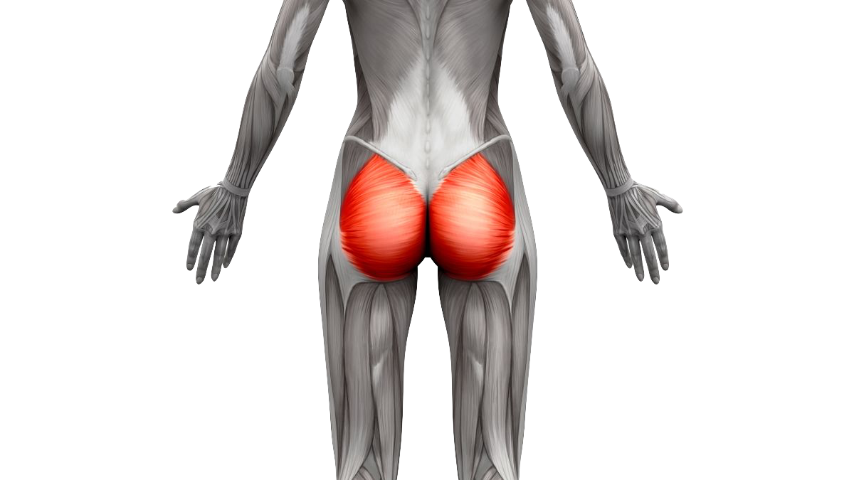
MUSCLS SET 6
GLUTEUS MAXIMUS
GLUTEUS MEDIUS
GLUTEUS MINIMUS
PIRIFORMIS
TENSOR FASCIA LATAE

Slide 32
Side Note: Fibers run down and to the side (lateral)
GLUTEUS MAXIMUS “rump”
O: Lateral Sacrum, Illiac Crest
I: Illiotibial Band (ITB)
A: Forceful extension of hip (from flexed
position); Lateral rotation of femur

Slide 33
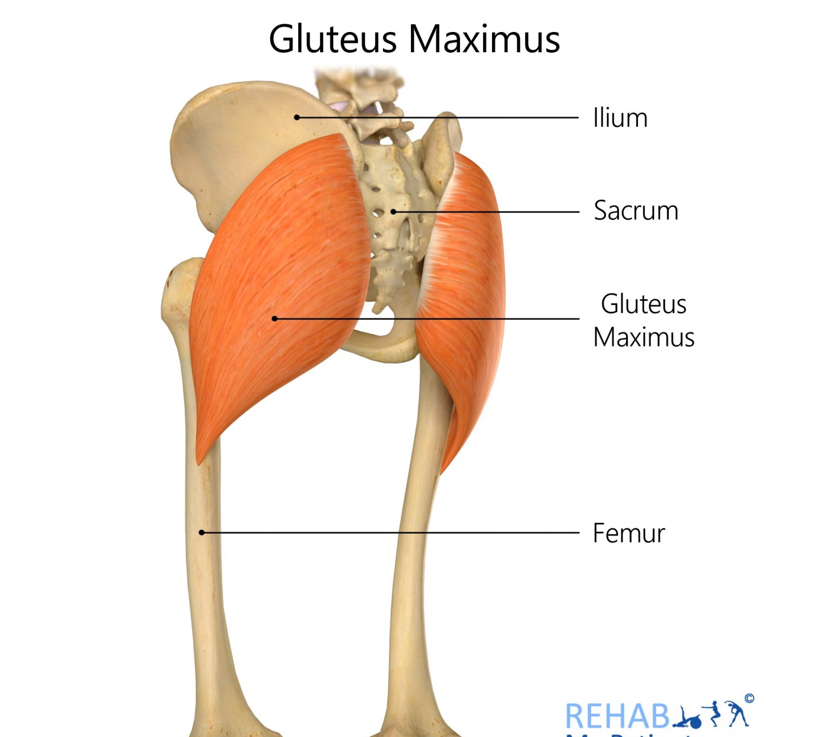
Gluteus Maximus

Slide 34
Side Note:
Commonly sore
GLUTEUS MEDIUS &
GLUTEUS MINIMUS
O: Posterior Ilium
I: Greater Trochanter
A: Medial Rotation, Abduction and
Extension of Femur

Slide 35
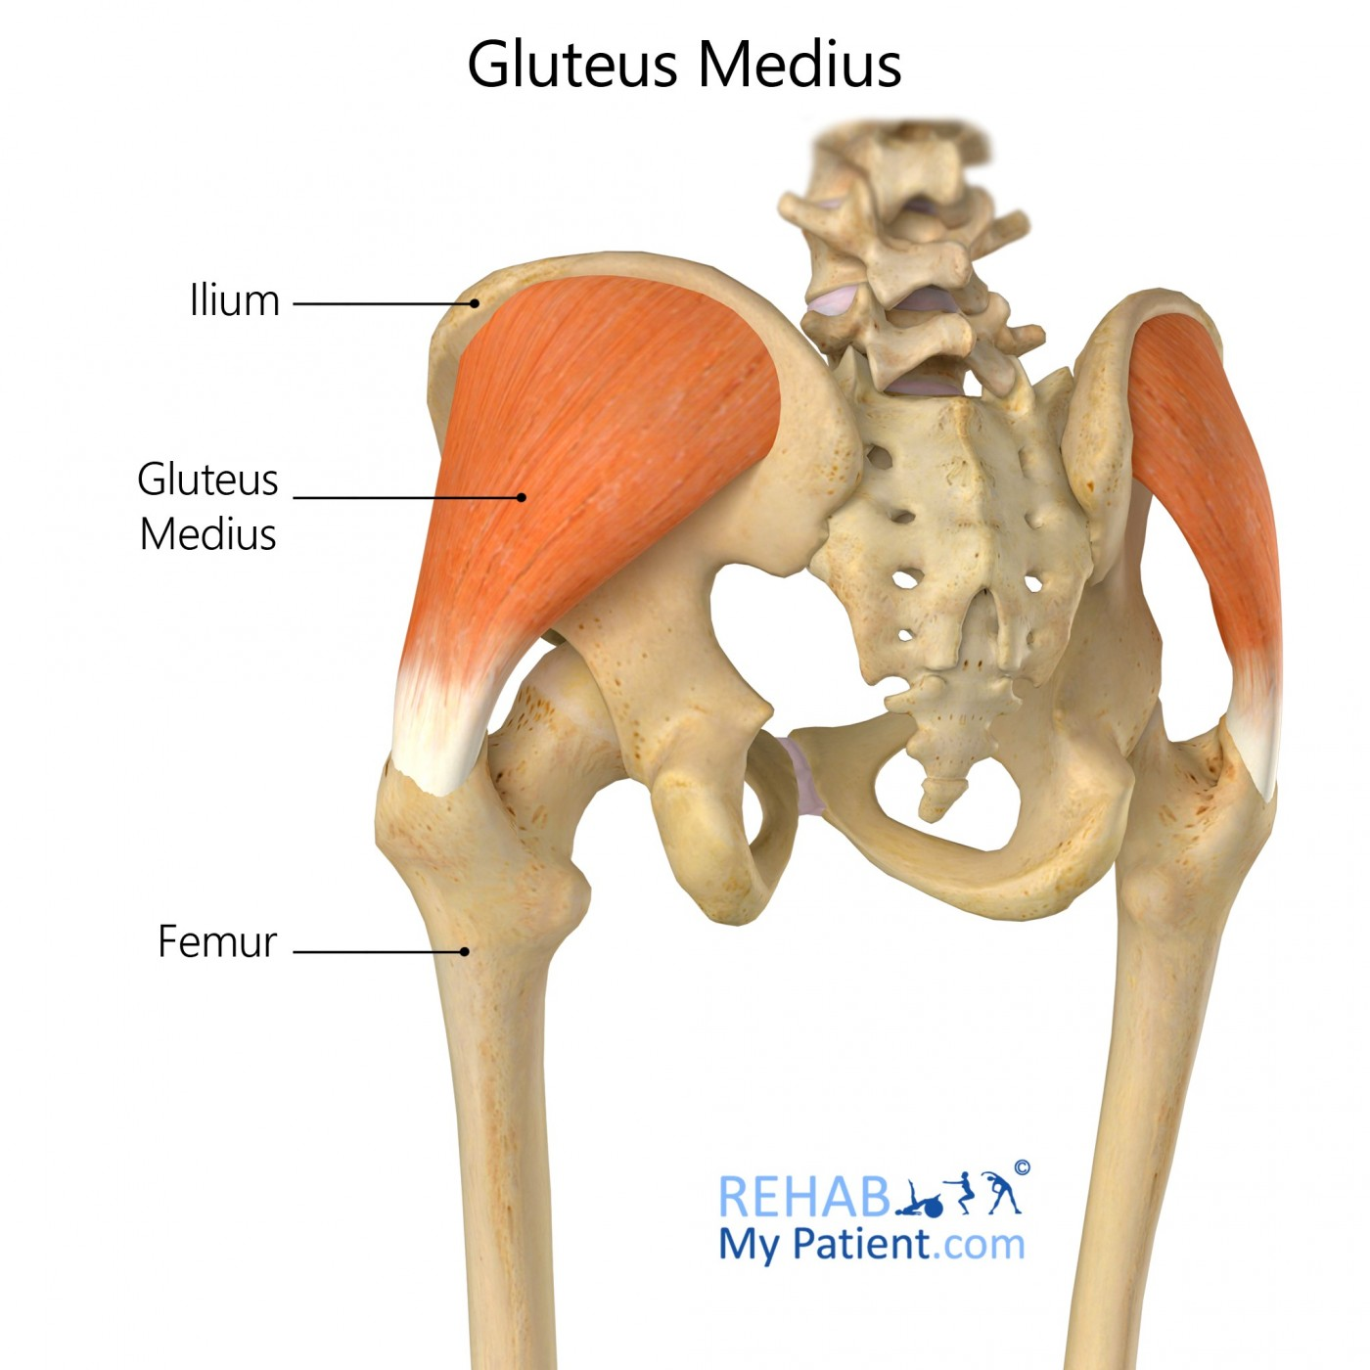
Gluteus Medius

Slide 36
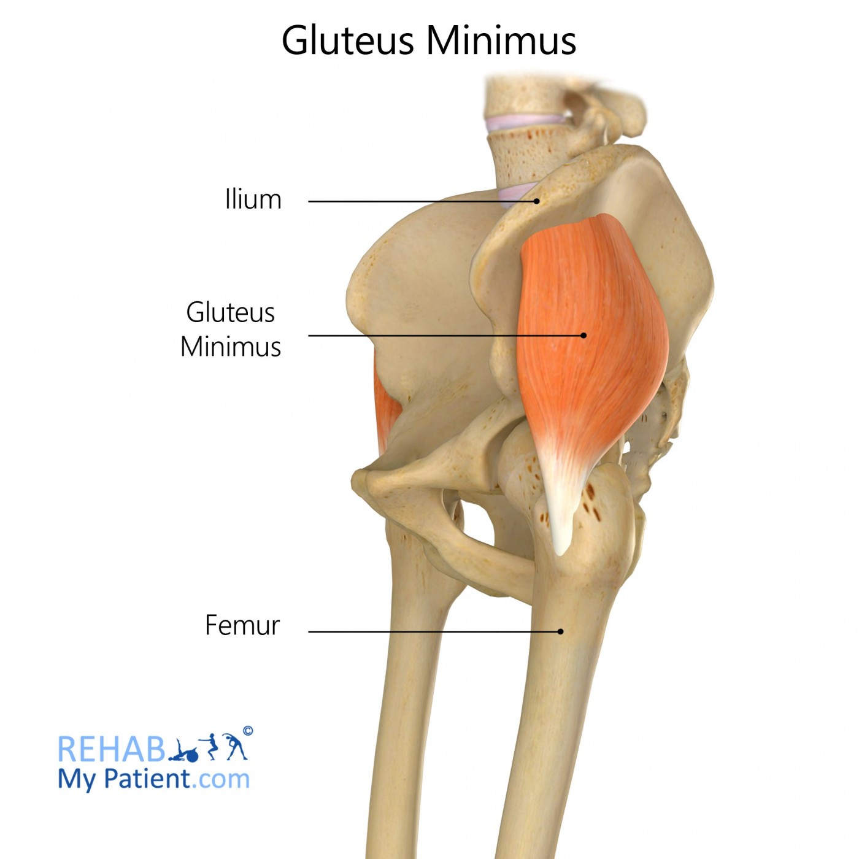
Gluteus Minimus

Slide 37
Side Note: Commonly tight/short.
PIRIFORMIS
O: Anterior Sacrum
I: Greater Trochanter
A: Lateral Rotation & Abduction of Femur

Slide 38
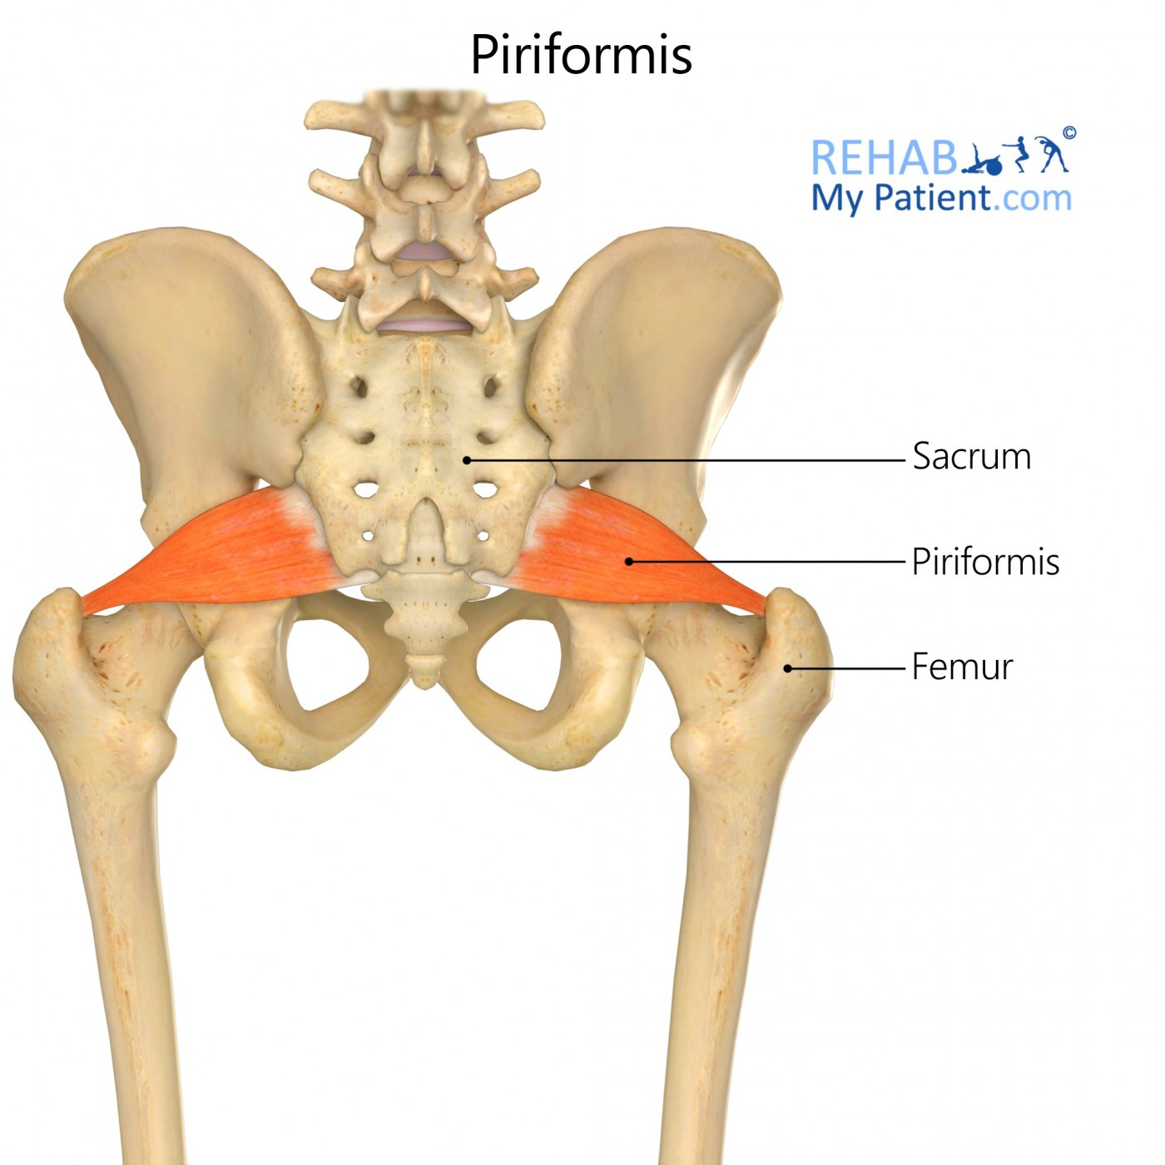
Piriformis

Slide 39
Side Note: Most
lateral hip muscles; Tight on Runners
TENSOR FASCIA LATAE (TFL)
O: Illiac Crest (Posterior to Anterior Superior Iliac Spine—ASIS)
I: Tibial Condyle via Illiotibial Band (ITB)
A: Abduction & Medial Rotation of Femur, Flexion at Hip, Stabilizes Knee

Slide 40
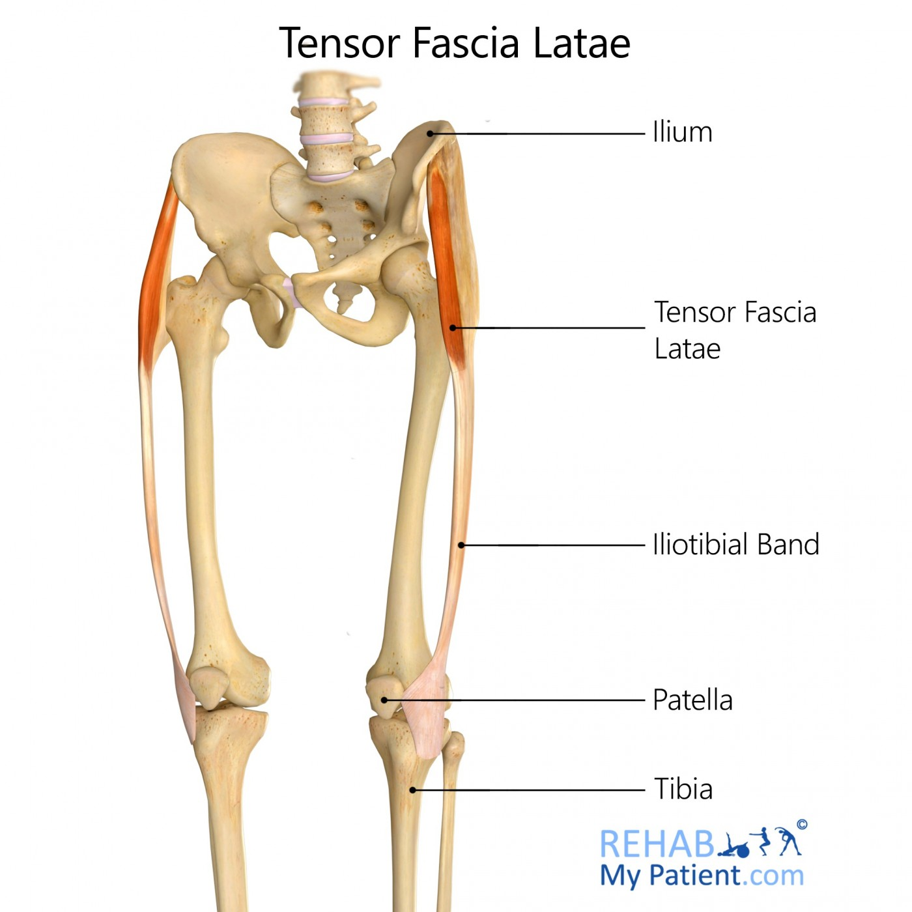
Tensor Fascia Latae

Slide 41
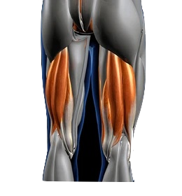
,
MUSCLS SET 7
HAMSTRINGS:
Biceps Femoris
Semimembranosus
Semtendinosis
ADDUCTOR MAGNUS
Gracilis

Slide 42
BICEPS FEMORIS
O: Longhead - Ischial Tuberosity
Shorthead - Linea Aspera
I: Head of the Fibula
A: Flexion of the knee; Extension of hip
Lateral rotation of hip

Slide 43
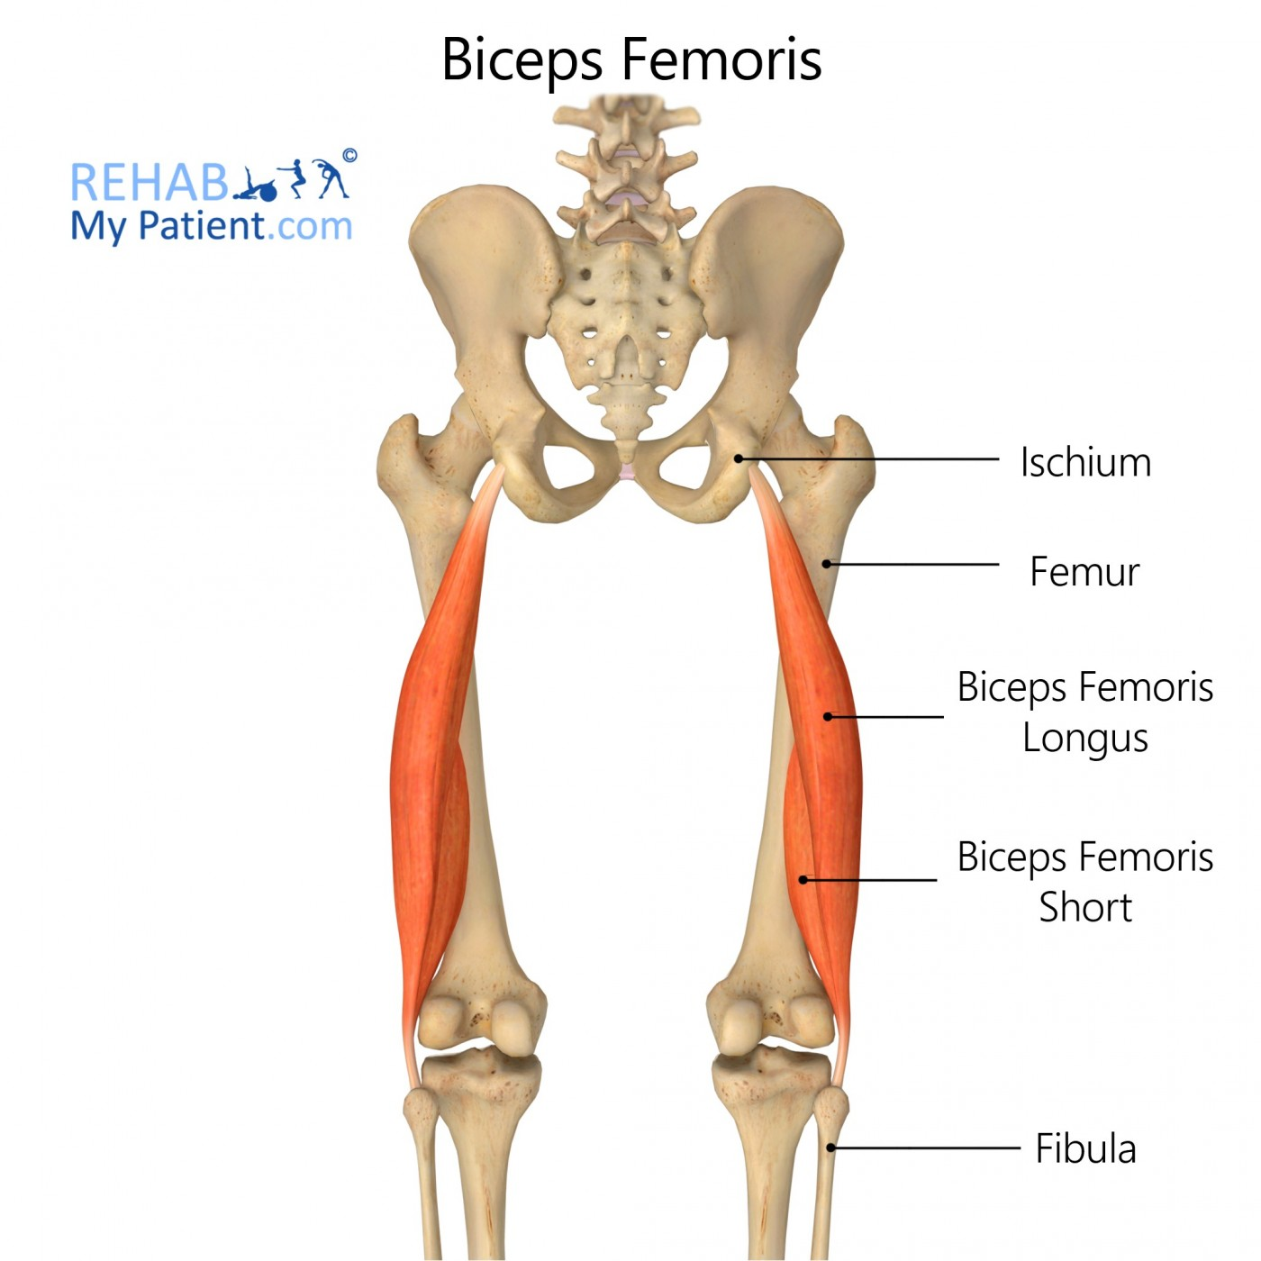
Biceps Femoris

Slide 44
SEMIMEMBRANOSUS (Most Medial)
SEMITENDINOSUS
O: Ischial Tuberosity
I: Tibial Condyle
A: Flexion of knee; Extension of hip
Medial rotation of hip

Slide 45
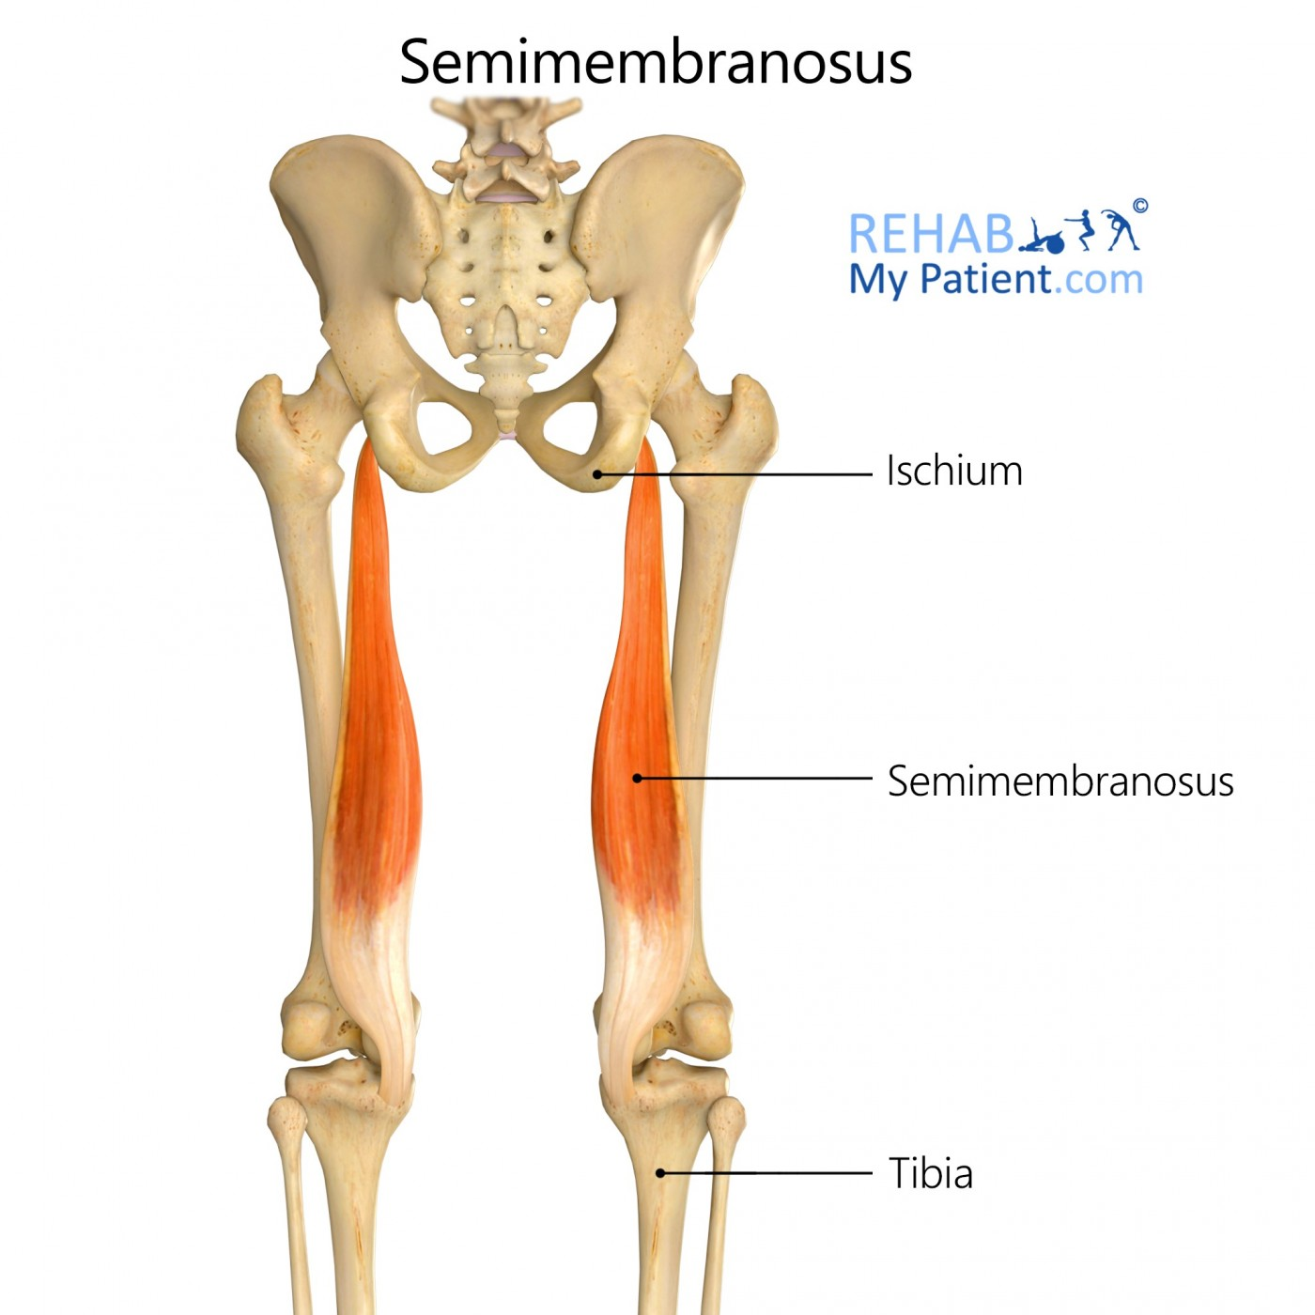
Semimembranosus

Slide 46
Semitendinosus

Slide 47
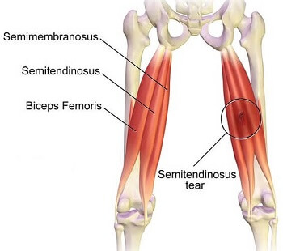

Slide 48
ADDUCTOR MAGNUS (PRIMARY STUDY NOTES)
O: -Hamstring part: Ischial tuberosity
I: -Hamstring part: Adductor tubercle of femur
A: Hamstring part:
-Hip adduction
-Hip extension

Slide 49
ADDUCTOR MAGNUS’ OTHER DIMENSION
O: -Adductor part: Inferior pubic ramus
& ischial ramus
I: -Adductor part: Linea aspera & medial
supracondylar line of femur
A: Adductor Hip adduction & Hip flexion

Slide 50
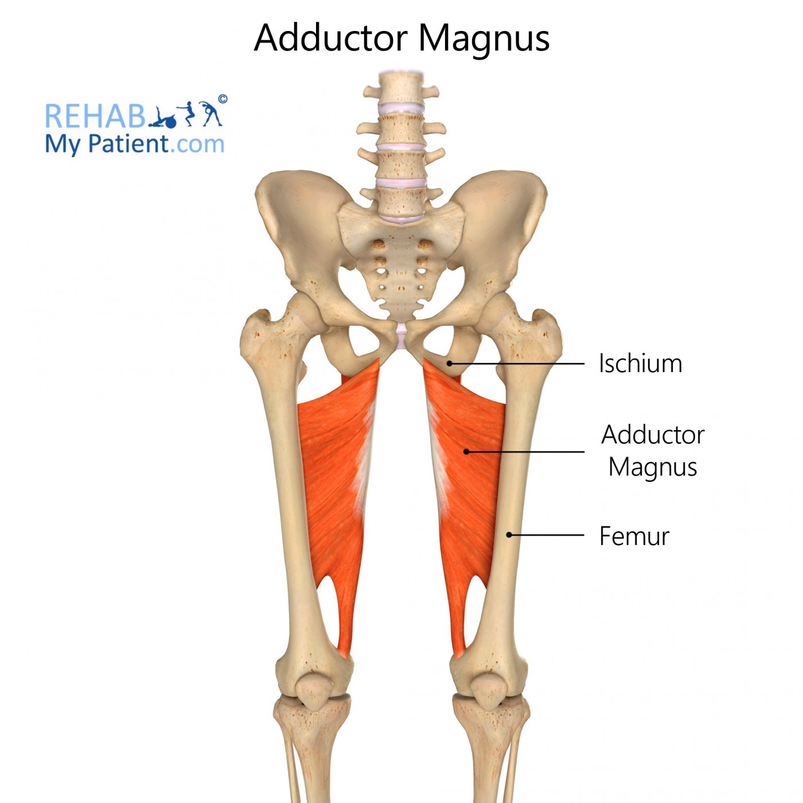
ADDUCTOR MAGNUS

Slide 51
GRACILIS
O: -Lower margin of pubic bone
I: -Superomedial shaft of tibia in between the
sartorius and semitendinosus insertions.
A: Adducts hip
-Flexes knee
-Medially rotates knee when flexed

Slide 52
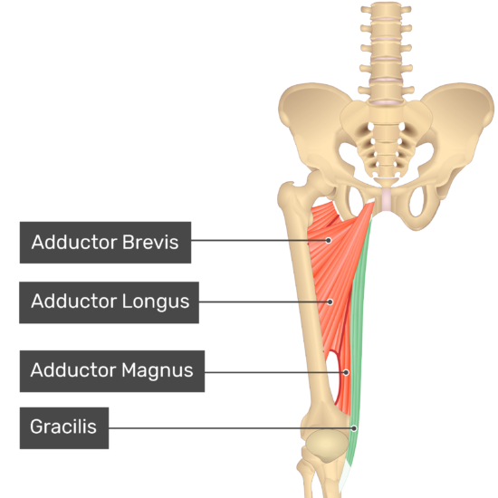
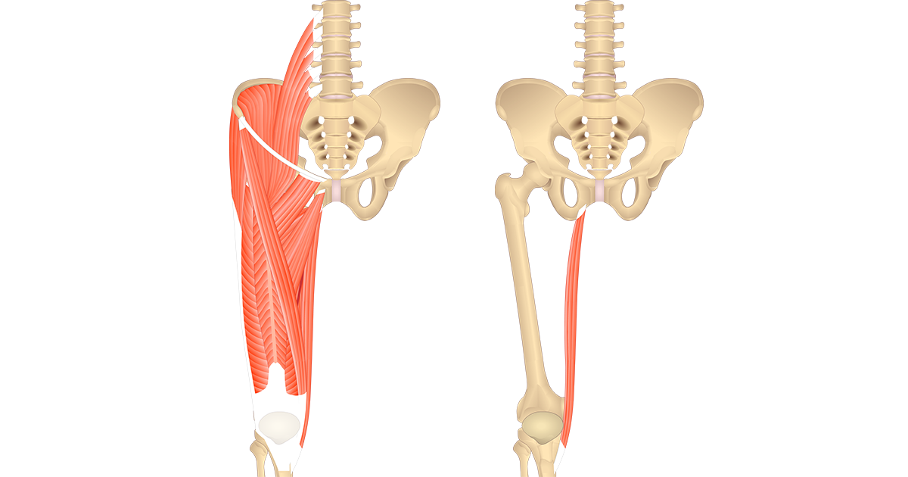
GRACILIS

Slide 53
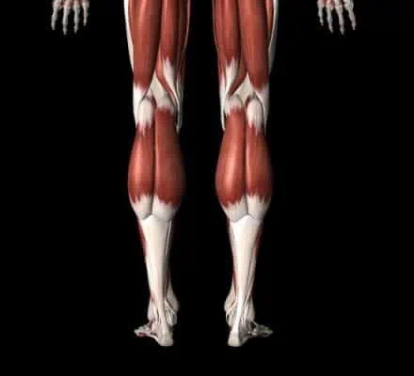
MUSCLS SET 8
GASTROCNEMIUS
SOLEUS
TIBIALIS POSTERIOR
PERONEUS LONGUS

Slide 54
Side Note: Most
Superficial calf muscle
GASTROCNEMIUS
O: Medial & Lateral Epicondyles of Femur
I: Calcaneus via Achilles Tendon
A: Plantar Flexion of Ankle OR Flexion of Knee

Slide 55
Gastrocnemius

Slide 56
Side Note: Biggest & Strongest Leg Muscle
SOLEUS
O: Soleal Line of Tibia (back of Tibia)
I: Calcaneus via Achilles Tendon
A: Plantar Flexion of Ankle

Slide 57
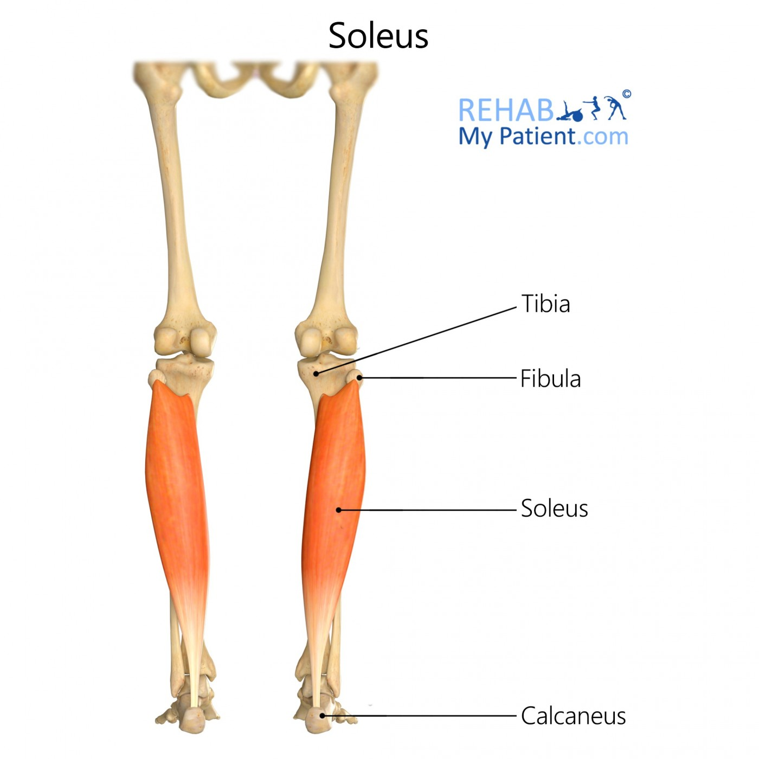
Soleus

Slide 58
TIBIALUS POSTERIOR
O: -Posterior surface of tibia
-Posterior surface of fibula
-Posterior interosseous membrane
I: Navicular tuberosity, cuneiforms, cuboid,
2-4 metatarsals, and sustentaculum tali of
calcaneus.
A: Inverts and planter flexes foot

Slide 59
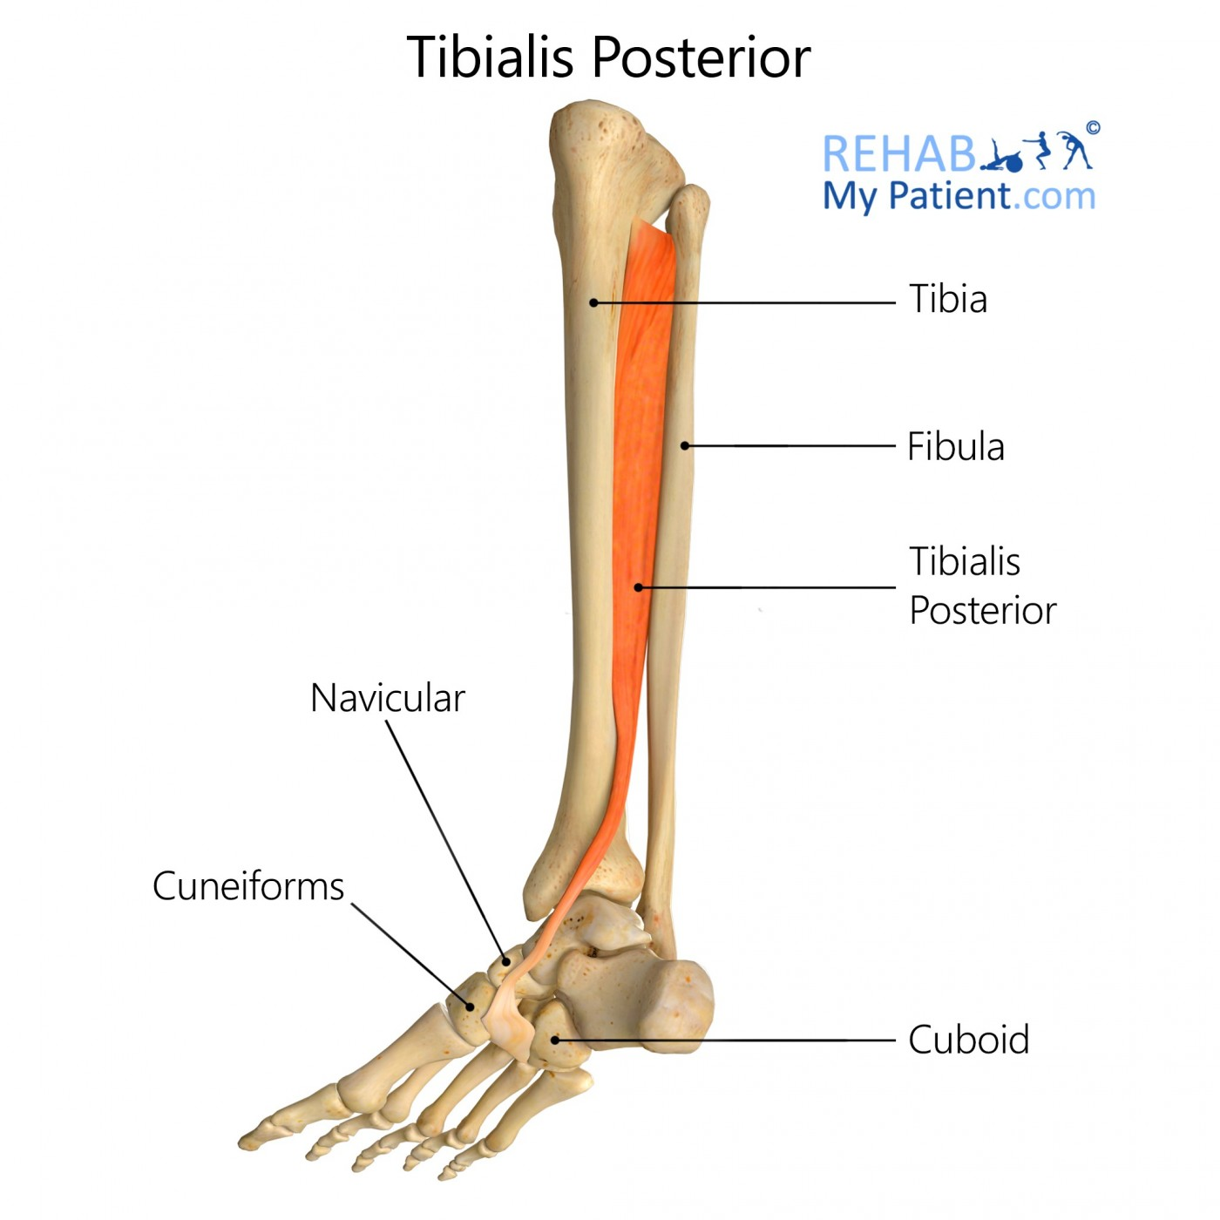
TIBIALIS
POSTERIOR

Slide 60
Side Note: Biggest & Strongest Peroneus Muscle
PERONEUS LONGUS
O: Head of the Fibula; Lateral Shaft of Fibula
I: Base of 1st Metatarsal (big toe)
A: Eversion; Plantar Flexion

Slide 61
Peroneus Longus

Slide 62
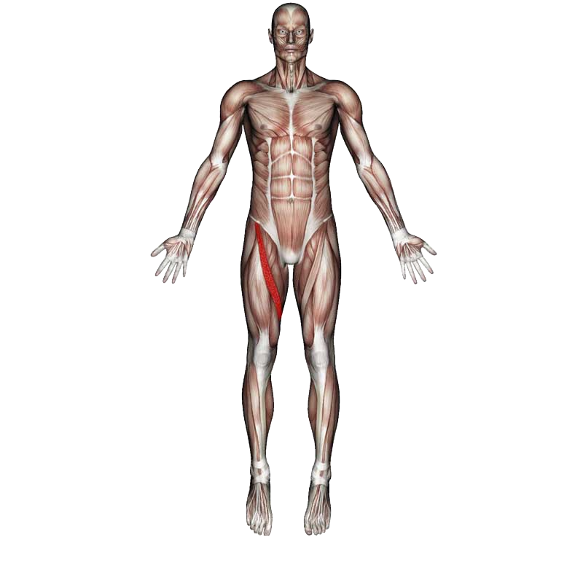
MUSCLE SET 9
TIBIALIS ANTERIOR QUADRICEPS
SARTORIUS
ADDUCTOR LONGUS

Slide 63
TIBIALIS ANTERIOR
O: - Lateral Shaft of Tibia
I: - Base of 1st Metatarsal
(crosses over top of foot)
A: - Dorsiflexion
- Inversion
https://www.google.com/url?sa=i&url=https%3A%2F%2Fwww.rehabmypatient.com%2Fneck%2Fsplenius-capitis&psig=AOvVaw0nKhpe0cvDVS8vVO8gL2W3&ust=1675164469599000&source=images&cd=vfe&ved=0CA8QjRxqFwoTCOiu04yY7_wCFQAAAAAdAAAAABAV
Side Notes:
- Shin Splints

Slide 64
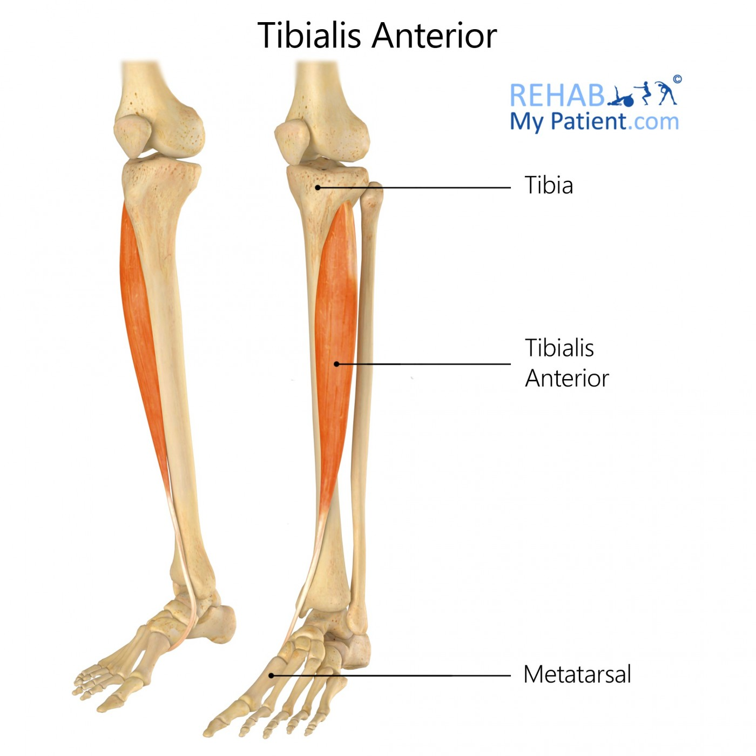
TIBIALIS ANTERIOR

Slide 65
RECTUS FEMORIS
O: - Anterior, Inferior Iliac Spine
I: - Tibial Tuberosity (via Patella & Patella
Ligament)
A: - Extend Knee
- Flex hip
https://www.google.com/url?sa=i&url=https%3A%2F%2Fwww.rehabmypatient.com%2Fneck%2Fsplenius-capitis&psig=AOvVaw0nKhpe0cvDVS8vVO8gL2W3&ust=1675164469599000&source=images&cd=vfe&ved=0CA8QjRxqFwoTCOiu04yY7_wCFQAAAAAdAAAAABAV

Slide 66
VASTUS LATERALIS
O: - Lateral Lip of Linea Aspera
- Glutal Tuberosity
- Greater Trochanter
I: - Tibial Tuberosity
A: - Extend Knee
- Flex hip
https://www.google.com/url?sa=i&url=https%3A%2F%2Fwww.rehabmypatient.com%2Fneck%2Fsplenius-capitis&psig=AOvVaw0nKhpe0cvDVS8vVO8gL2W3&ust=1675164469599000&source=images&cd=vfe&ved=0CA8QjRxqFwoTCOiu04yY7_wCFQAAAAAdAAAAABAV

Slide 67
VASTUS MEDIALIS
O: - Medial Lip of Linea Aspera
I: - Tibial Tuberosity
A: - Extend Knee
- Flex hip
https://www.google.com/url?sa=i&url=https%3A%2F%2Fwww.rehabmypatient.com%2Fneck%2Fsplenius-capitis&psig=AOvVaw0nKhpe0cvDVS8vVO8gL2W3&ust=1675164469599000&source=images&cd=vfe&ved=0CA8QjRxqFwoTCOiu04yY7_wCFQAAAAAdAAAAABAV

Slide 68
VASTUS INTERMEDIUS
O: - Anterior & Lateral Shaft of Femur
I: - Tibial Tuberosity
A: - Extend Knee
- Flex hip
https://www.google.com/url?sa=i&url=https%3A%2F%2Fwww.rehabmypatient.com%2Fneck%2Fsplenius-capitis&psig=AOvVaw0nKhpe0cvDVS8vVO8gL2W3&ust=1675164469599000&source=images&cd=vfe&ved=0CA8QjRxqFwoTCOiu04yY7_wCFQAAAAAdAAAAABAV

Slide 69
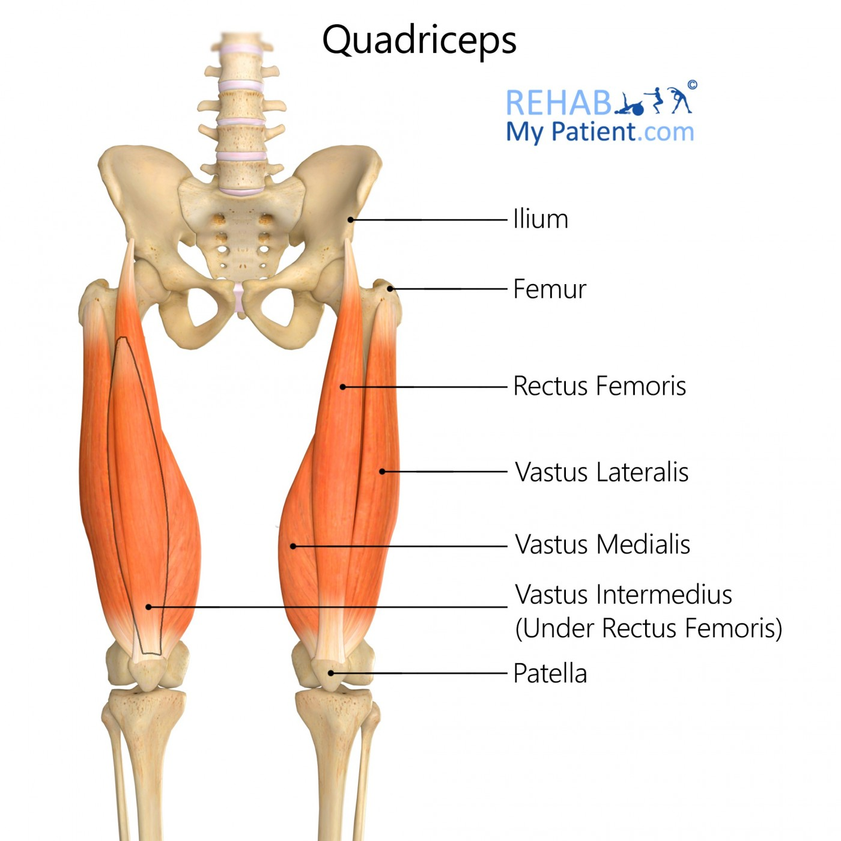
QUADRICEPS
https://www.google.com/url?sa=i&url=https%3A%2F%2Fwww.rehabmypatient.com%2Fneck%2Fsplenius-capitis&psig=AOvVaw0nKhpe0cvDVS8vVO8gL2W3&ust=1675164469599000&source=images&cd=vfe&ved=0CA8QjRxqFwoTCOiu04yY7_wCFQAAAAAdAAAAABAV

Slide 70
SARTORIUS
O: - Anterior Superior Iliac Spine (ASIS)
I: - Medial Tibia
A: - Hip Extension
- Knee Flexion
- Lateral Rotation
https://www.google.com/url?sa=i&url=https%3A%2F%2Fwww.rehabmypatient.com%2Fneck%2Fsplenius-capitis&psig=AOvVaw0nKhpe0cvDVS8vVO8gL2W3&ust=1675164469599000&source=images&cd=vfe&ved=0CA8QjRxqFwoTCOiu04yY7_wCFQAAAAAdAAAAABAV
Side Notes:
- Longest muscle in the body.
- Most superficial thigh muscle.
- Crosses over hip and knee joints.
- AKA: Tailor Muscle

Slide 71
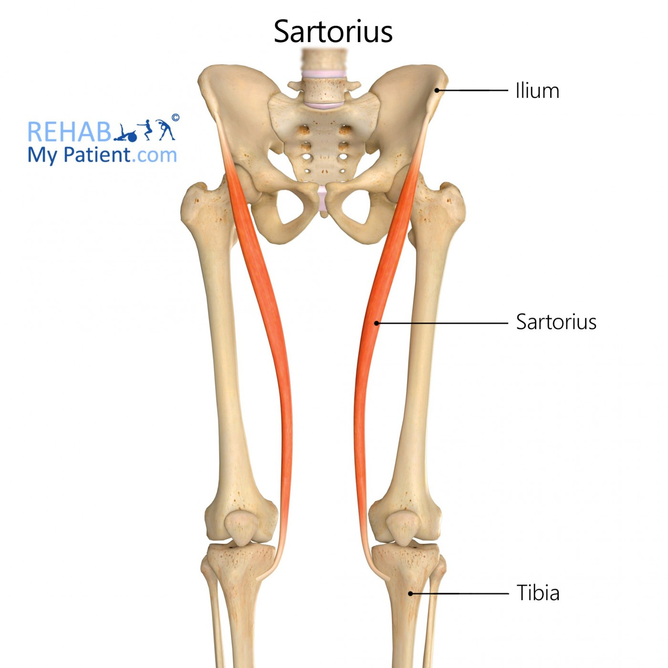
SARTORIUS
https://www.google.com/url?sa=i&url=https%3A%2F%2Fwww.rehabmypatient.com%2Fneck%2Fsplenius-capitis&psig=AOvVaw0nKhpe0cvDVS8vVO8gL2W3&ust=1675164469599000&source=images&cd=vfe&ved=0CA8QjRxqFwoTCOiu04yY7_wCFQAAAAAdAAAAABAV

Slide 72
ADDUCTOR LONGUS
O: - Body of the pubis (inferior to the pubic crest)
I: - Middle third of linea aspera of femur (medial lip)
A: - Hip Adduction & Flexion
https://www.google.com/url?sa=i&url=https%3A%2F%2Fwww.rehabmypatient.com%2Fneck%2Fsplenius-capitis&psig=AOvVaw0nKhpe0cvDVS8vVO8gL2W3&ust=1675164469599000&source=images&cd=vfe&ved=0CA8QjRxqFwoTCOiu04yY7_wCFQAAAAAdAAAAABAV

Slide 73
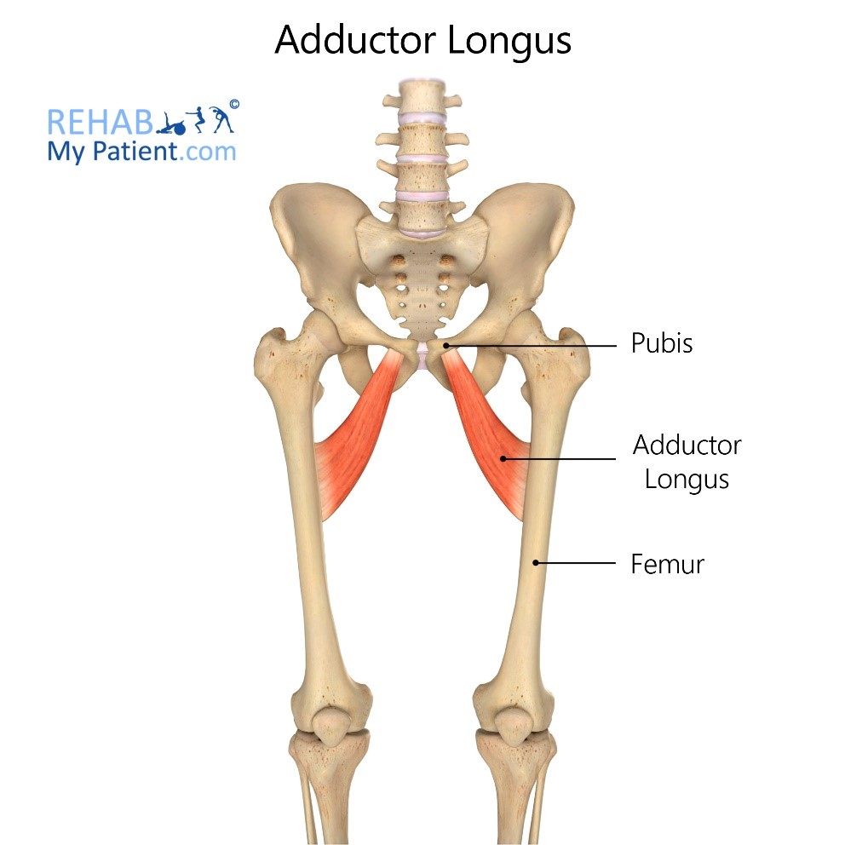
ADDUCUTOR LONGUS
https://www.google.com/url?sa=i&url=https%3A%2F%2Fwww.rehabmypatient.com%2Fneck%2Fsplenius-capitis&psig=AOvVaw0nKhpe0cvDVS8vVO8gL2W3&ust=1675164469599000&source=images&cd=vfe&ved=0CA8QjRxqFwoTCOiu04yY7_wCFQAAAAAdAAAAABAV

Slide 74
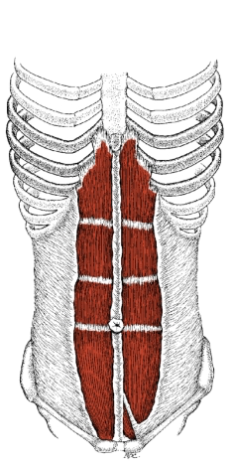
MUSCLE SET 10
RECTUS ABDOMINUS
OBLIQUES
(EXTERNAL, INTERNAL) TRANSVERSUS ABDOMINIS
ILIOPSOAS

Slide 75
RECTUS ABDOMINUS
O: - Xiphoid Process (pointy part on end
of sternum)
I: - Public Bone
A: - Flexion of the Spine
- Expels content out of respective
openings (air, fluids, solids)
https://www.google.com/url?sa=i&url=https%3A%2F%2Fwww.rehabmypatient.com%2Fneck%2Fsplenius-capitis&psig=AOvVaw0nKhpe0cvDVS8vVO8gL2W3&ust=1675164469599000&source=images&cd=vfe&ved=0CA8QjRxqFwoTCOiu04yY7_wCFQAAAAAdAAAAABAV

Slide 76
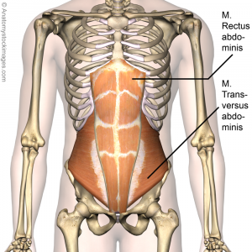
RECTUS
Rectus
Abdominus
ABDOMINUS
Transversus
Abdominus
https://www.google.com/url?sa=i&url=https%3A%2F%2Fwww.rehabmypatient.com%2Fneck%2Fsplenius-capitis&psig=AOvVaw0nKhpe0cvDVS8vVO8gL2W3&ust=1675164469599000&source=images&cd=vfe&ved=0CA8QjRxqFwoTCOiu04yY7_wCFQAAAAAdAAAAABAV

Slide 77
EXTERNAL OBLIQUE
O: - Thoracolumbar Aponeurosis (TLA)
I: - Linea Alba via the External Oblique
Aponeurosis
A: - Rotation of the trunk to the opposite side
- Lateral Flexion
- Expels Content out of Respective
Openings
https://www.google.com/url?sa=i&url=https%3A%2F%2Fwww.rehabmypatient.com%2Fneck%2Fsplenius-capitis&psig=AOvVaw0nKhpe0cvDVS8vVO8gL2W3&ust=1675164469599000&source=images&cd=vfe&ved=0CA8QjRxqFwoTCOiu04yY7_wCFQAAAAAdAAAAABAV

Slide 78
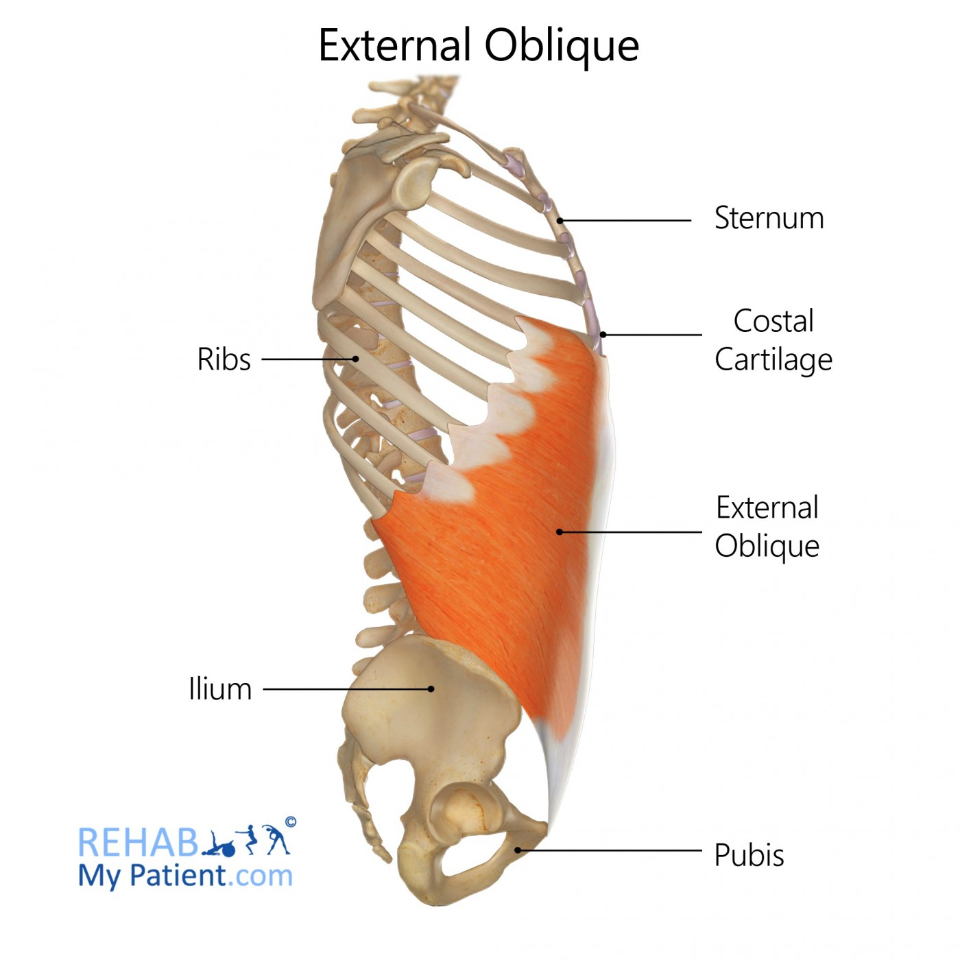
EXTERNAL OBLIQUE
https://www.google.com/url?sa=i&url=https%3A%2F%2Fwww.rehabmypatient.com%2Fneck%2Fsplenius-capitis&psig=AOvVaw0nKhpe0cvDVS8vVO8gL2W3&ust=1675164469599000&source=images&cd=vfe&ved=0CA8QjRxqFwoTCOiu04yY7_wCFQAAAAAdAAAAABAV

Slide 79
INTERNAL OBLIQUE
O: - Thoracolumbar Aponeurosis (TLA)
- Iliac Crest
I: - Linea Alba via the Interal Oblique
Aponeurosis
A: - Rotation of the trunk to the same side
- Lateral Flexion
- Expels Content out of Respective Openings
https://www.google.com/url?sa=i&url=https%3A%2F%2Fwww.rehabmypatient.com%2Fneck%2Fsplenius-capitis&psig=AOvVaw0nKhpe0cvDVS8vVO8gL2W3&ust=1675164469599000&source=images&cd=vfe&ved=0CA8QjRxqFwoTCOiu04yY7_wCFQAAAAAdAAAAABAV

Slide 80
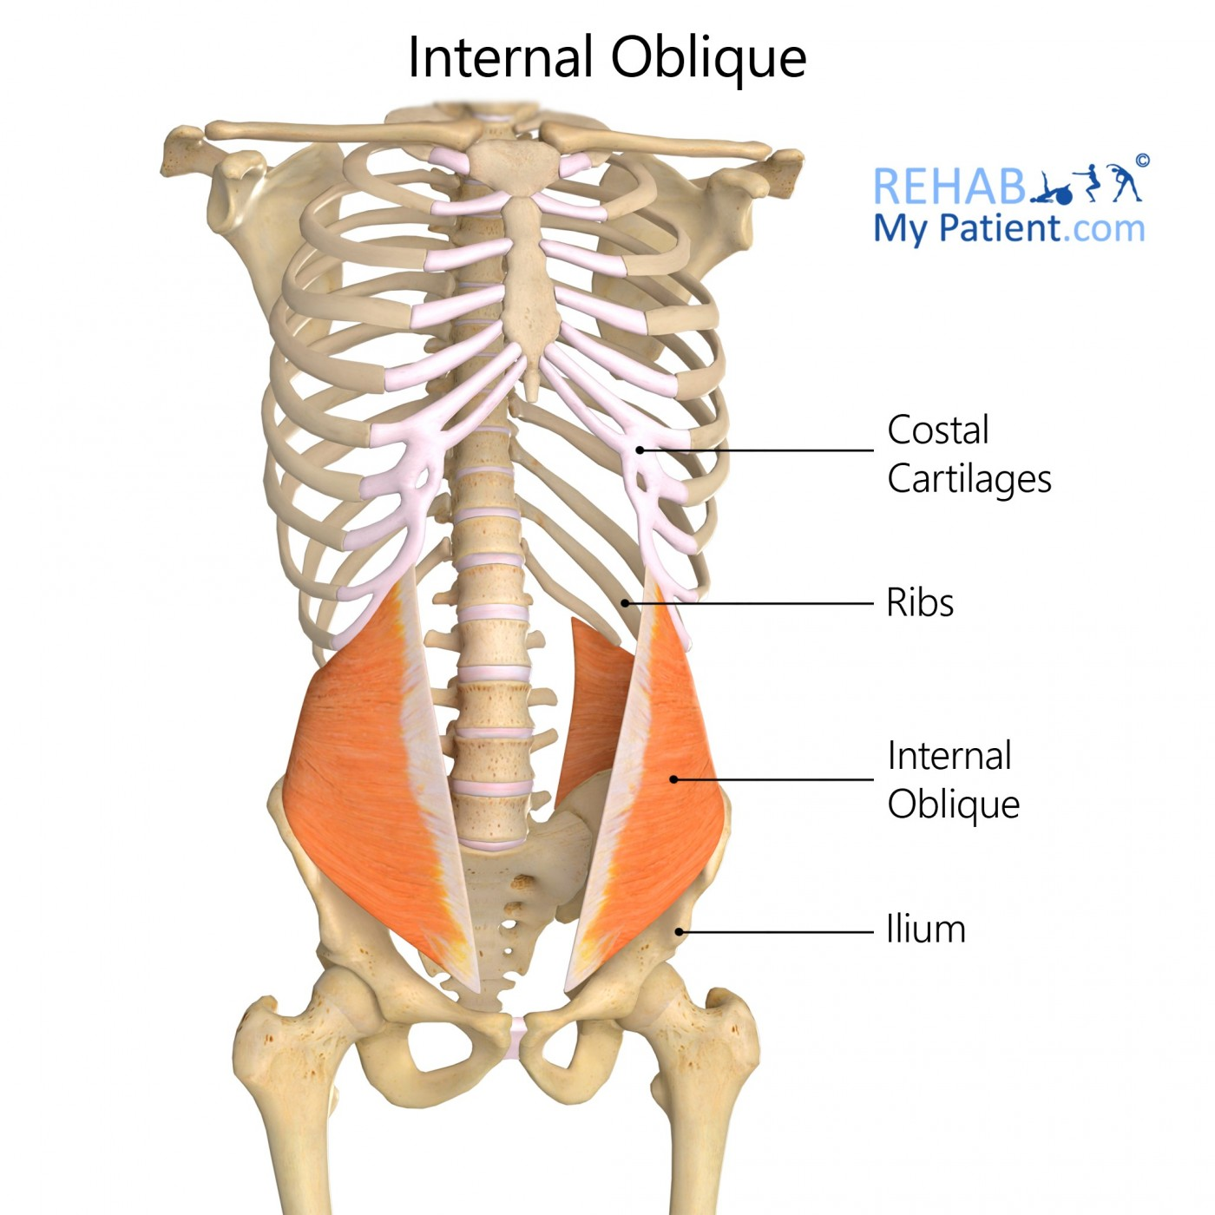
INTERNAL OBLIQUE
https://www.google.com/url?sa=i&url=https%3A%2F%2Fwww.rehabmypatient.com%2Fneck%2Fsplenius-capitis&psig=AOvVaw0nKhpe0cvDVS8vVO8gL2W3&ust=1675164469599000&source=images&cd=vfe&ved=0CA8QjRxqFwoTCOiu04yY7_wCFQAAAAAdAAAAABAV

Slide 81
TRANSVERSUS ABDOMINIS
O: - Costal cartilages of the seventh to twelfth
ribs/Thoracolumbar fascia/Iliac crest/Inguinal
ligament
I: - Linea Alba/Pubic crest via conjoint tendon/
Pectineal line of the pubis (pecten pubis) via
conjoint tendon
A: - supports core/compresses abdomen to increases
intrabdominal pressure, which aids forced expiration,
urination & defecation
https://www.google.com/url?sa=i&url=https%3A%2F%2Fwww.rehabmypatient.com%2Fneck%2Fsplenius-capitis&psig=AOvVaw0nKhpe0cvDVS8vVO8gL2W3&ust=1675164469599000&source=images&cd=vfe&ved=0CA8QjRxqFwoTCOiu04yY7_wCFQAAAAAdAAAAABAV

Slide 82
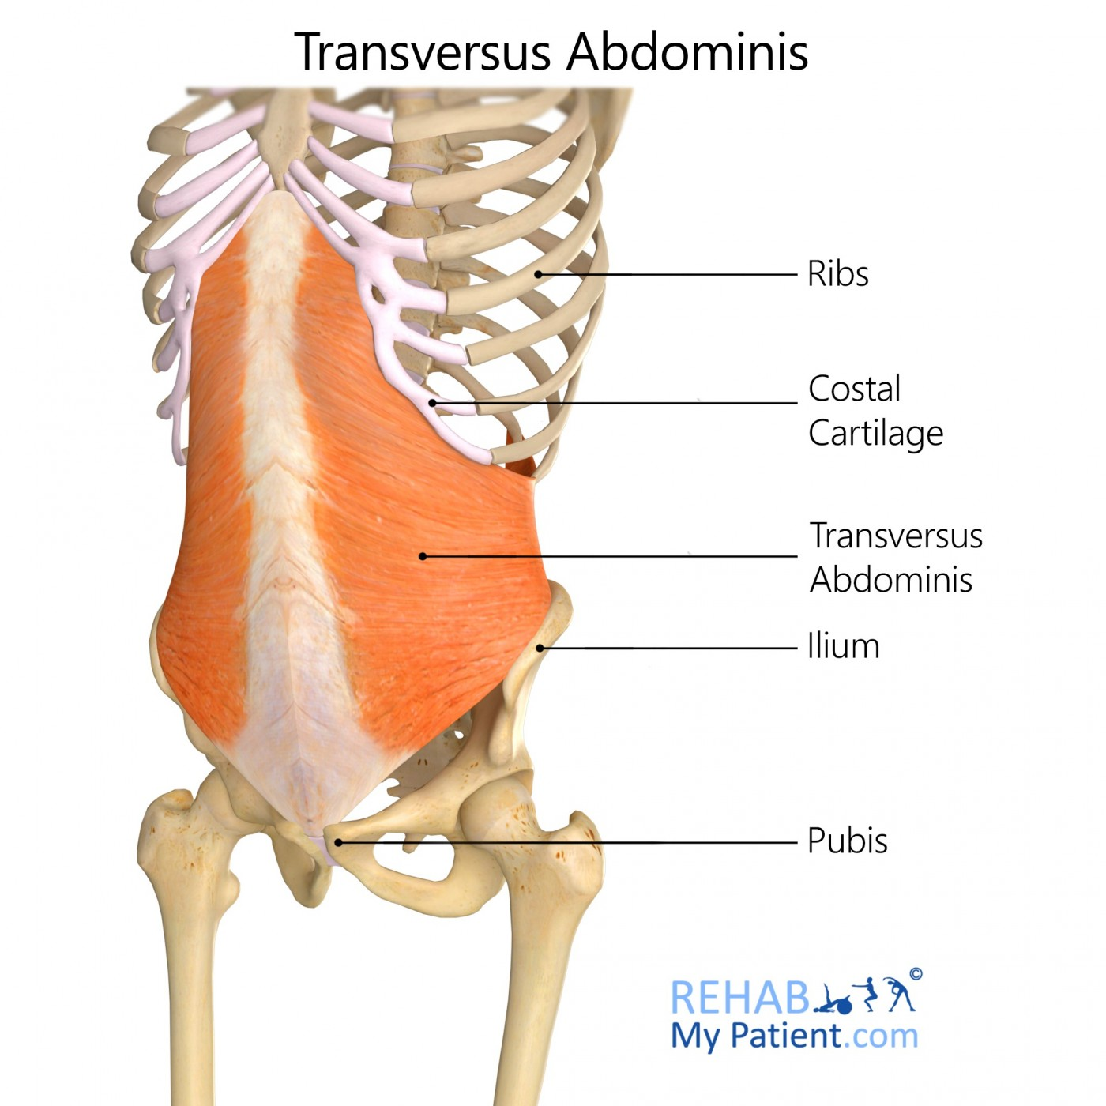
TRANSVERSUS
ABDOMINIS
https://www.google.com/url?sa=i&url=https%3A%2F%2Fwww.rehabmypatient.com%2Fneck%2Fsplenius-capitis&psig=AOvVaw0nKhpe0cvDVS8vVO8gL2W3&ust=1675164469599000&source=images&cd=vfe&ved=0CA8QjRxqFwoTCOiu04yY7_wCFQAAAAAdAAAAABAV

Slide 83
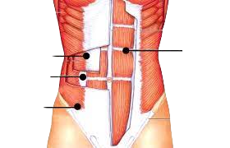
Transversus
Abdominus
Rectus Abdominis
https://www.google.com/url?sa=i&url=https%3A%2F%2Fwww.rehabmypatient.com%2Fneck%2Fsplenius-capitis&psig=AOvVaw0nKhpe0cvDVS8vVO8gL2W3&ust=1675164469599000&source=images&cd=vfe&ved=0CA8QjRxqFwoTCOiu04yY7_wCFQAAAAAdAAAAABAV
Internal Oblique
External
Oblique

Slide 84
PSOAS MAJOR
O: - Transverse processes of lumbar vertebrae;
lateral lumbar vertebral bodies.
I: - Middle surface of lesser trochanter of femur.
A: - Flexes and laterally rotates thigh at hip.
- Flexes vertebral column.
https://www.google.com/url?sa=i&url=https%3A%2F%2Fwww.rehabmypatient.com%2Fneck%2Fsplenius-capitis&psig=AOvVaw0nKhpe0cvDVS8vVO8gL2W3&ust=1675164469599000&source=images&cd=vfe&ved=0CA8QjRxqFwoTCOiu04yY7_wCFQAAAAAdAAAAABAV

Slide 85
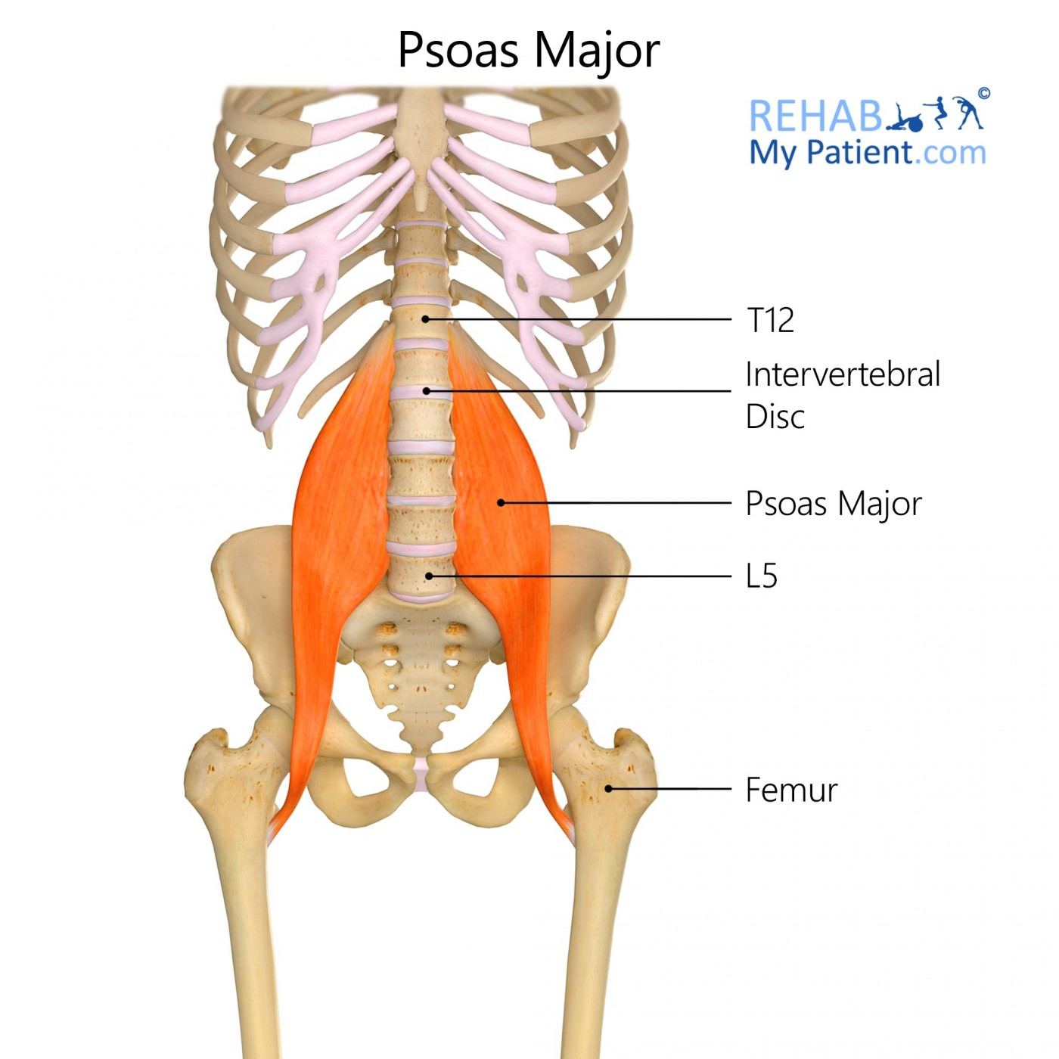
https://www.google.com/url?sa=i&url=https%3A%2F%2Fwww.rehabmypatient.com%2Fneck%2Fsplenius-capitis&psig=AOvVaw0nKhpe0cvDVS8vVO8gL2W3&ust=1675164469599000&source=images&cd=vfe&ved=0CA8QjRxqFwoTCOiu04yY7_wCFQAAAAAdAAAAABAV
PSOAS MAJOR

Slide 86
ILIACUS
O: - Iliac fossa
I: - Lesser trochanter of femur
A: - Hip flexion
https://www.google.com/url?sa=i&url=https%3A%2F%2Fwww.rehabmypatient.com%2Fneck%2Fsplenius-capitis&psig=AOvVaw0nKhpe0cvDVS8vVO8gL2W3&ust=1675164469599000&source=images&cd=vfe&ved=0CA8QjRxqFwoTCOiu04yY7_wCFQAAAAAdAAAAABAV

Slide 87
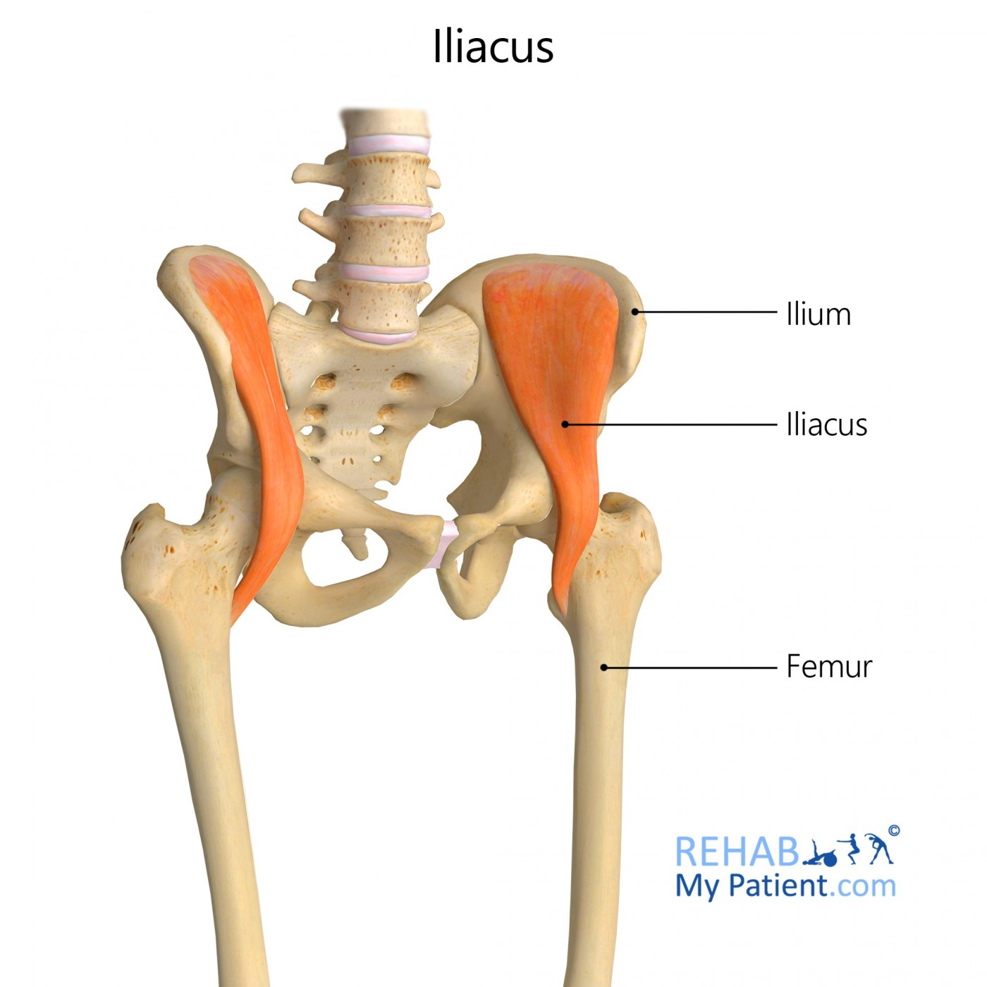
https://www.google.com/url?sa=i&url=https%3A%2F%2Fwww.rehabmypatient.com%2Fneck%2Fsplenius-capitis&psig=AOvVaw0nKhpe0cvDVS8vVO8gL2W3&ust=1675164469599000&source=images&cd=vfe&ved=0CA8QjRxqFwoTCOiu04yY7_wCFQAAAAAdAAAAABAV
ILIACUS

Slide 88
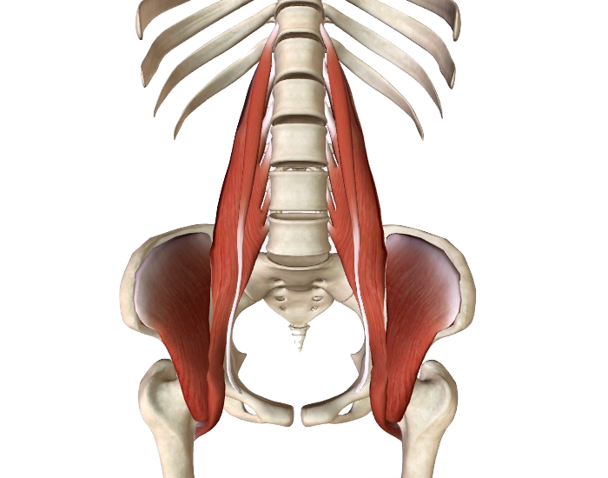
ILIOPSOAS
The iliacus and the psoas muscles are often collectively referred to as the iliopsoas due to the fact that they share an attachment at the lesser trochanter of the femur.
https://www.google.com/url?sa=i&url=https%3A%2F%2Fwww.rehabmypatient.com%2Fneck%2Fsplenius-capitis&psig=AOvVaw0nKhpe0cvDVS8vVO8gL2W3&ust=1675164469599000&source=images&cd=vfe&ved=0CA8QjRxqFwoTCOiu04yY7_wCFQAAAAAdAAAAABAV

Slide 89
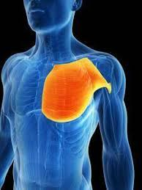
MUSCLS SET 11
PECTORALIS MAJOR
PECTORALIS MINOR

Slide 90
PECTORALIS MAJOR
O: Sternum
I: Bicipital Groove of Humerus (lateral lip)
A: -Adduction of Humerus
-Horizontal Adduction
-Medial Rotation of Humerus
*Flexion of extended shoulder
* Extension of flexed shoulder
Side Note: Tight

Slide 91
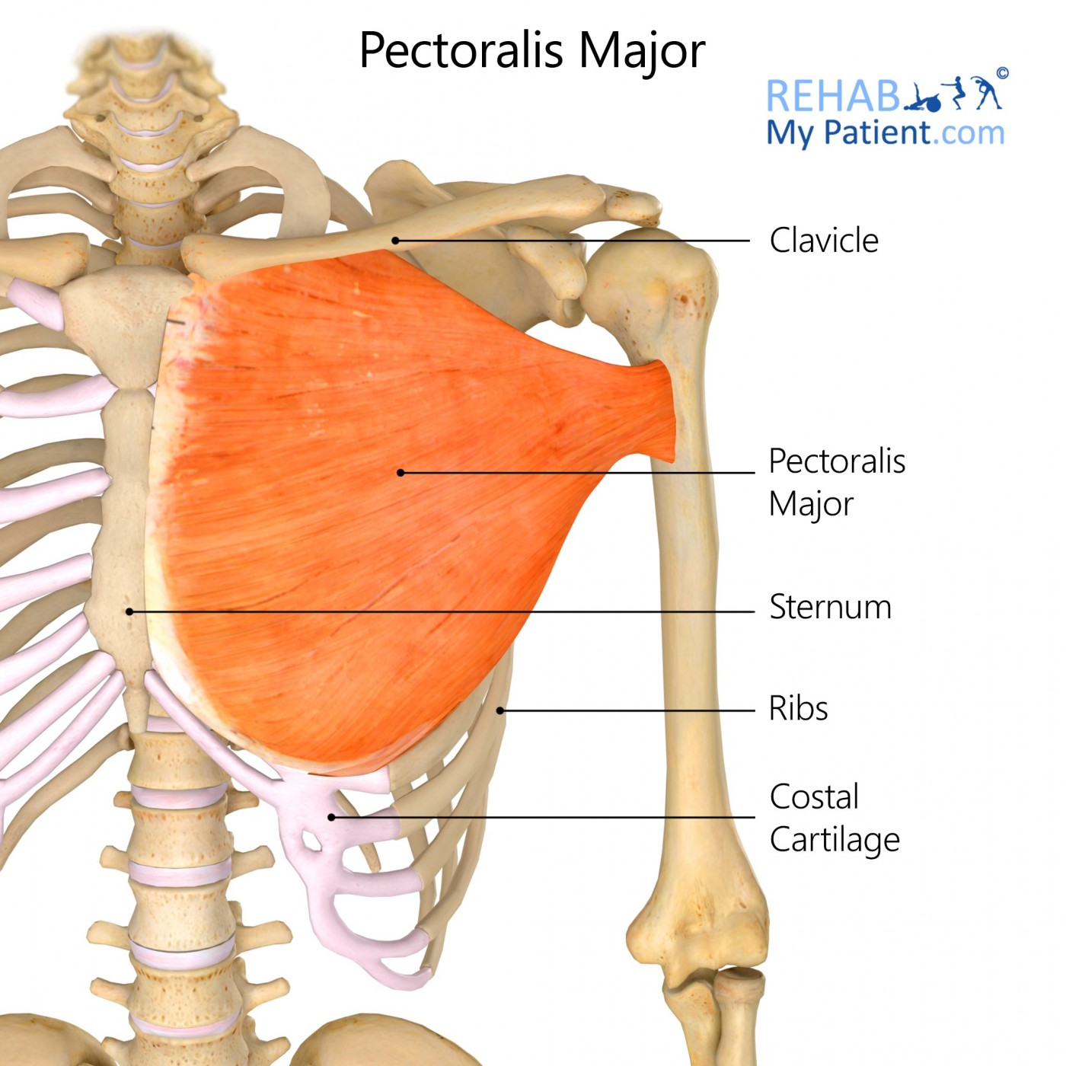
Pectoralis Major
https://www.google.com/url?sa=i&url=https%3A%2F%2Fwww.rehabmypatient.com%2Fneck%2Fsplenius-capitis&psig=AOvVaw0nKhpe0cvDVS8vVO8gL2W3&ust=1675164469599000&source=images&cd=vfe&ved=0CA8QjRxqFwoTCOiu04yY7_wCFQAAAAAdAAAAABAV

Slide 92
PECTORALIS MINOR
O: Coracoid Process (anterior scapula)
I: 3rd, 4th, 5th rib
A: -Protraction of Scapula
-Depression of Scapula
-Forced Inspiration
+Synergist: Serratus Anterior

Slide 93
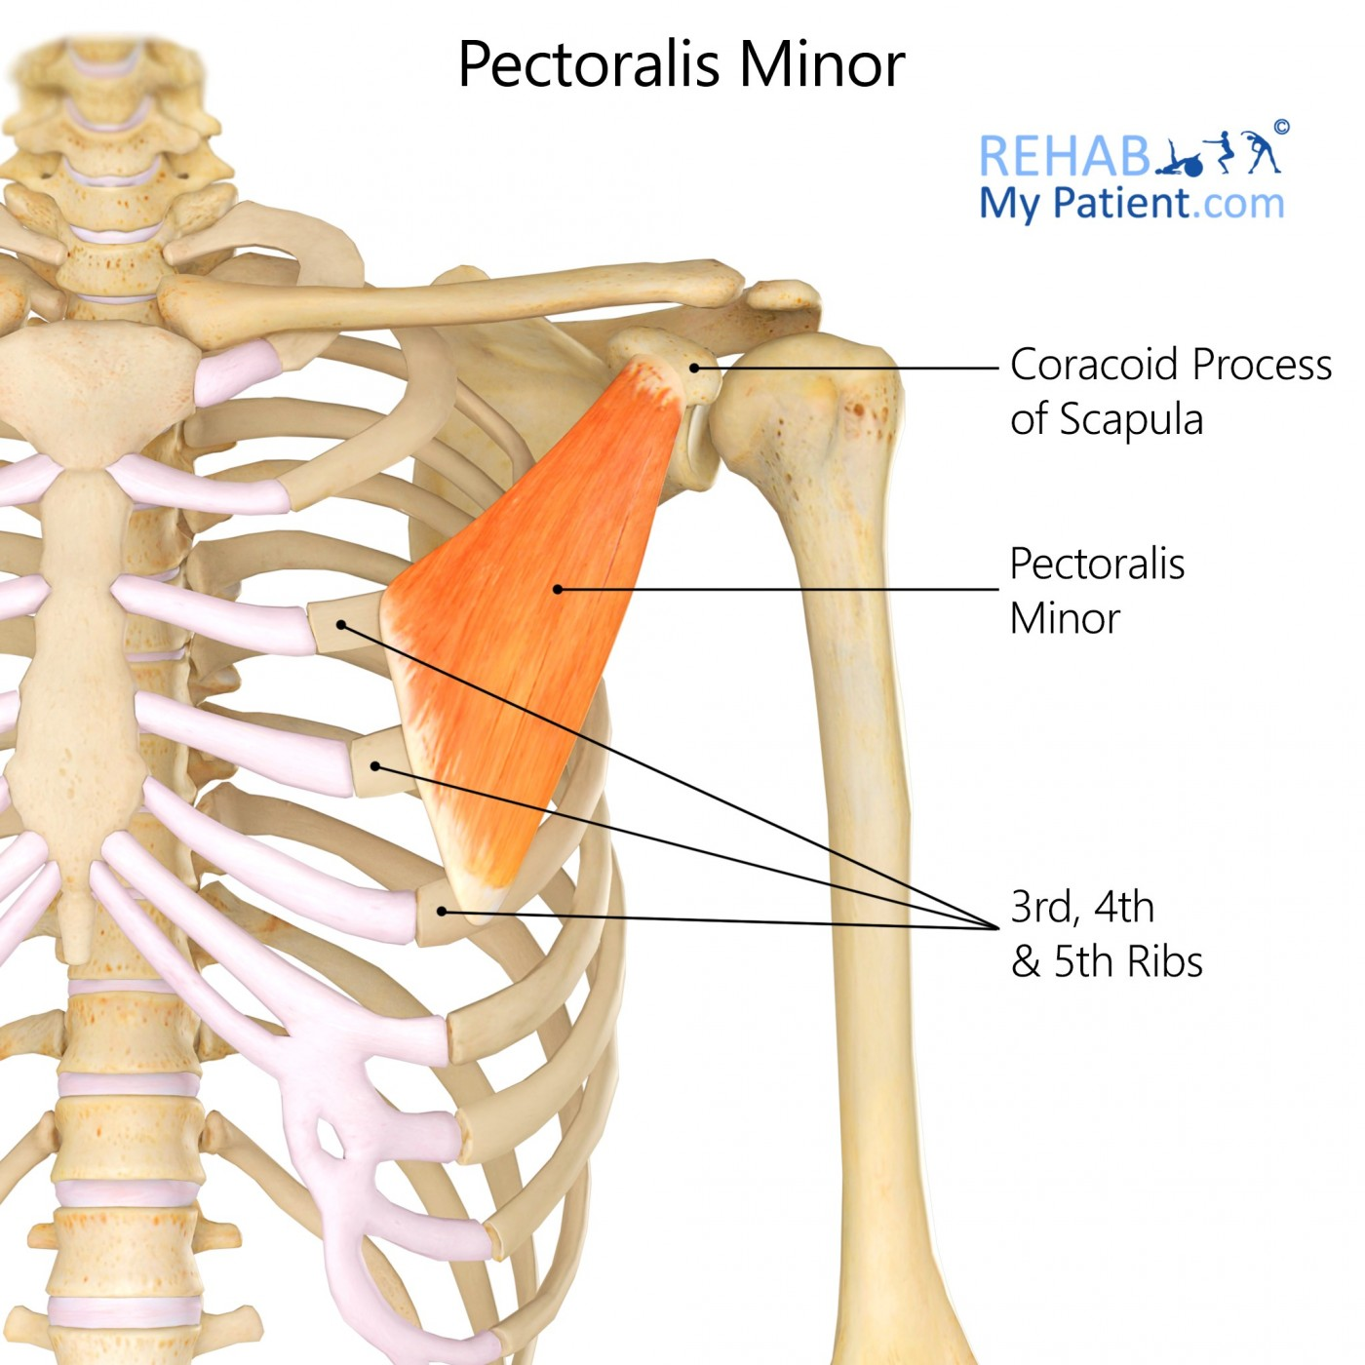
Pectoralis Minor
https://www.google.com/url?sa=i&url=https%3A%2F%2Fwww.rehabmypatient.com%2Fneck%2Fsplenius-capitis&psig=AOvVaw0nKhpe0cvDVS8vVO8gL2W3&ust=1675164469599000&source=images&cd=vfe&ved=0CA8QjRxqFwoTCOiu04yY7_wCFQAAAAAdAAAAABAV

Slide 94
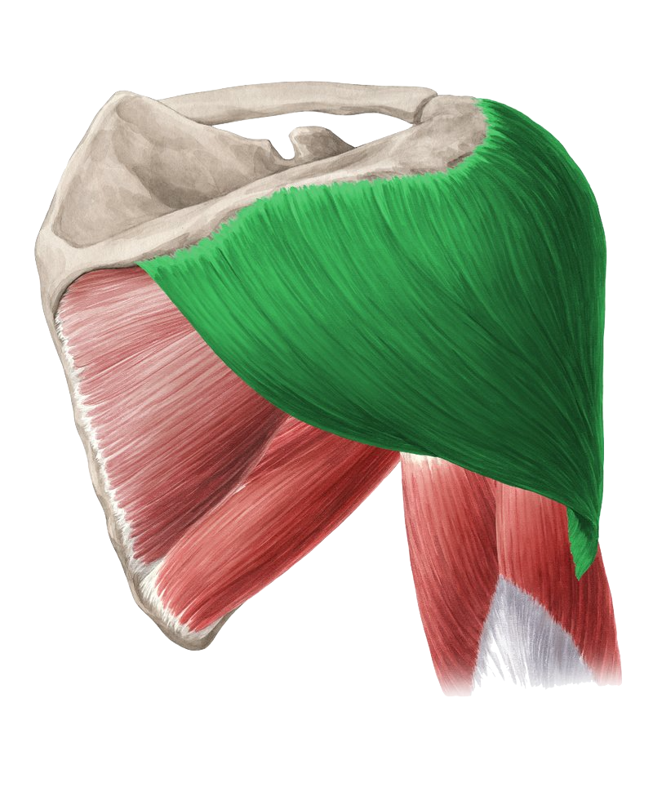
MUSCLS SET 12
DELTOID
BICEPS BRACHII
TRICEPS BRACHII

Slide 95
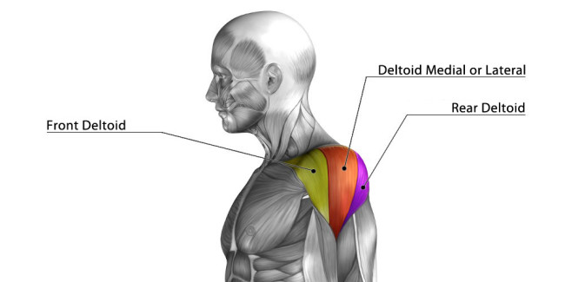
DELTOID
(Classified as 1
muscle with 3 parts)
Medial/Lateral Deltoid
Posterior Deltoid
Anterior Deltoid
https://www.google.com/url?sa=i&url=https%3A%2F%2Fwww.rehabmypatient.com%2Fneck%2Fsplenius-capitis&psig=AOvVaw0nKhpe0cvDVS8vVO8gL2W3&ust=1675164469599000&source=images&cd=vfe&ved=0CA8QjRxqFwoTCOiu04yY7_wCFQAAAAAdAAAAABAV

Slide 96
DELTOIDS (ANTERIOR)
O: Lateral 1/3 of Clavicle (Superior Surface
and Anterior Border of Clavicle)
I: Deltoid Tuberosity
A: -Forward Flexion of Humerus
-Medial Rotation of Humerus

Slide 97
DELTOID
(Anterior)
Anterior
https://www.google.com/url?sa=i&url=https%3A%2F%2Fwww.rehabmypatient.com%2Fneck%2Fsplenius-capitis&psig=AOvVaw0nKhpe0cvDVS8vVO8gL2W3&ust=1675164469599000&source=images&cd=vfe&ved=0CA8QjRxqFwoTCOiu04yY7_wCFQAAAAAdAAAAABAV

Slide 98
DELTOIDS (LATERAL/MIDDLE)
O: Acromion Process
I: Deltoid Tuberosity
A: Medial Rotation of Humerus

Slide 99
DELTOID
(Lateral/Medial)
https://www.google.com/url?sa=i&url=https%3A%2F%2Fwww.rehabmypatient.com%2Fneck%2Fsplenius-capitis&psig=AOvVaw0nKhpe0cvDVS8vVO8gL2W3&ust=1675164469599000&source=images&cd=vfe&ved=0CA8QjRxqFwoTCOiu04yY7_wCFQAAAAAdAAAAABAV
Lateral/Medial

Slide 100
Side Note: Overstretched
DELTOIDS (POSTERIOR)
O: Posterior Spine of Scapula
I: Deltoid Tuberosity
A: -Extension of Shoulder
-Horizontal Abduction of Shoulder
-Lateral Rotation of Humerus

Slide 101
DELTOID
(Posterior)
https://www.google.com/url?sa=i&url=https%3A%2F%2Fwww.rehabmypatient.com%2Fneck%2Fsplenius-capitis&psig=AOvVaw0nKhpe0cvDVS8vVO8gL2W3&ust=1675164469599000&source=images&cd=vfe&ved=0CA8QjRxqFwoTCOiu04yY7_wCFQAAAAAdAAAAABAV
Posterior

Slide 102
BICEPS BRACHII
O: Long - Supraglenoid Tubercle of Scapula
Short - Coracoid Process
I: Radial Tuberosity
A: -Flexion of Elbow
-Flexion of Shoulder
-Supination
Side Notes:
- Tight
- shortens w/ age
- “Popeye’s Syndrome”

Slide 103
BICEPS
BRACHII
https://www.google.com/url?sa=i&url=https%3A%2F%2Fwww.rehabmypatient.com%2Fneck%2Fsplenius-capitis&psig=AOvVaw0nKhpe0cvDVS8vVO8gL2W3&ust=1675164469599000&source=images&cd=vfe&ved=0CA8QjRxqFwoTCOiu04yY7_wCFQAAAAAdAAAAABAV

Slide 104
TRICEPS BRACHII
O: - Long - Infraglenoid Tubercle of Scapula
- Medial - Posterior Humerus (below spiral groove)
- Lateral - Posterior Humerus
(above spiral groove)
I: Olecranon Process (elbow)
A: -Extension of Elbow
-Long - Extension of Shoulder
Side Notes:
- Overstretched
- 2/3 bigger than biceps
- only muscle that does
extension of elbow

Slide 105
TRICEPS
BRACHII
https://www.google.com/url?sa=i&url=https%3A%2F%2Fwww.rehabmypatient.com%2Fneck%2Fsplenius-capitis&psig=AOvVaw0nKhpe0cvDVS8vVO8gL2W3&ust=1675164469599000&source=images&cd=vfe&ved=0CA8QjRxqFwoTCOiu04yY7_wCFQAAAAAdAAAAABAV

Slide 106
MUSCLS SET 13
BRACHIORADIALIS
FOREARM FLEXORS
FOREARM EXTENSORS

Slide 107
BRACHIORADIALIS
O: - Lateral supracondylar ridge of humerus
I: - Styloid process of Radius (Lateral surface)
A: -Flexion of the forearm at the elbow joint
-Supination and pronation of the forearm

Slide 108
BRACHIORADIALIS
https://www.google.com/url?sa=i&url=https%3A%2F%2Fwww.rehabmypatient.com%2Fneck%2Fsplenius-capitis&psig=AOvVaw0nKhpe0cvDVS8vVO8gL2W3&ust=1675164469599000&source=images&cd=vfe&ved=0CA8QjRxqFwoTCOiu04yY7_wCFQAAAAAdAAAAABAV

Slide 109
FOREARM FLEXORS
O: - Medial Epicondyle of Humerus
I: - Hands & Fingers (anterior/palm side)
A: - Flexion of Hands & Fingers

Slide 110
FOREARM FLEXORS
https://www.google.com/url?sa=i&url=https%3A%2F%2Fwww.rehabmypatient.com%2Fneck%2Fsplenius-capitis&psig=AOvVaw0nKhpe0cvDVS8vVO8gL2W3&ust=1675164469599000&source=images&cd=vfe&ved=0CA8QjRxqFwoTCOiu04yY7_wCFQAAAAAdAAAAABAV

Slide 111
PRONATOR TERES
O: - Common Flexor Tendon from Medial Epicondyle of Humerus & Coronoid Process of the Ulna
I: - Middle of Lateral Surface of the Radius
A: - Pronates the Forearm

Slide 112
https://www.google.com/url?sa=i&url=https%3A%2F%2Fwww.rehabmypatient.com%2Fneck%2Fsplenius-capitis&psig=AOvVaw0nKhpe0cvDVS8vVO8gL2W3&ust=1675164469599000&source=images&cd=vfe&ved=0CA8QjRxqFwoTCOiu04yY7_wCFQAAAAAdAAAAABAV
PRONATOR TERES

Slide 113
FLEXOR CARPI RADIALIS LONGUS
O: - Medial Epicondyle of Humerus
I: - Base of 2nd and 3rd Metacarpals
A: - Flexion of the hand at wrist

Slide 114
FLEXOR CARPI RADIALIS LONGUS
https://www.google.com/url?sa=i&url=https%3A%2F%2Fwww.rehabmypatient.com%2Fneck%2Fsplenius-capitis&psig=AOvVaw0nKhpe0cvDVS8vVO8gL2W3&ust=1675164469599000&source=images&cd=vfe&ved=0CA8QjRxqFwoTCOiu04yY7_wCFQAAAAAdAAAAABAV
Flexor Carpi
Radialis Longus

Slide 115
PALMARIS
O: - Medial Epicondyle of Humerus
I: - Flexor Retinaculum
- Palmar aponeurosis
A: - Flexion of Wrist
- Tenses palmar aponeurosis

Slide 116
PALMARIS
https://www.google.com/url?sa=i&url=https%3A%2F%2Fwww.rehabmypatient.com%2Fneck%2Fsplenius-capitis&psig=AOvVaw0nKhpe0cvDVS8vVO8gL2W3&ust=1675164469599000&source=images&cd=vfe&ved=0CA8QjRxqFwoTCOiu04yY7_wCFQAAAAAdAAAAABAV

Slide 117
FLEXOR CARPI ULNARIS
O: - Medial Epicondyle of Humerus
I: - Base of 2nd & 3rd Metacarpal
A: - Flexion of Wrist
- Abduction of Wrist

Slide 118
FLEXOR CARPI ULNARIS

Slide 119
FLEXOR DIGITORUM SUPERFICIALIS
O: - Medial Epicondyle of Humerus
- Ulnar collateral ligament
- Coronoid Process of Ulna
I: - Bodies of 2nd to 5th Phalanges
A: - Flexion of Four Digits
- Flexion of proximal phalanges at
Metacarpophalangeal Joints

Slide 120
FLEXOR DIGITORUM SUPERFICIALIS

Slide 121
FOREARM EXTENSORS
O: - Lateral Epicondyle of Humerus (common extensor tendon)
I: - Hands & Fingers (posterior)
A: - Extension of hands and fingers
1. extensor digitorum
2. extensor carpi ulnaris
3. extensor digiti minimi
Side Note:
- 3 Forearm Extensors
- 4 Superficial Forearm
Extensors

Slide 122
FOREARM EXTENSORS
https://www.google.com/url?sa=i&url=https%3A%2F%2Fwww.rehabmypatient.com%2Fneck%2Fsplenius-capitis&psig=AOvVaw0nKhpe0cvDVS8vVO8gL2W3&ust=1675164469599000&source=images&cd=vfe&ved=0CA8QjRxqFwoTCOiu04yY7_wCFQAAAAAdAAAAABAV

Slide 123
EXTENSOR CARPI ULNARIS
O: - Lateral Epicondyle of Humerus (common extensor tendon)
I: - Base of 5th Metacarpal
A: - Extension of Wrists
- Adduction of Wrists
https://www.google.com/url?sa=i&url=https%3A%2F%2Fwww.rehabmypatient.com%2Fneck%2Fsplenius-capitis&psig=AOvVaw0nKhpe0cvDVS8vVO8gL2W3&ust=1675164469599000&source=images&cd=vfe&ved=0CA8QjRxqFwoTCOiu04yY7_wCFQAAAAAdAAAAABAV

Slide 124
EXTENSOR
CARPI ULNARIS
https://www.google.com/url?sa=i&url=https%3A%2F%2Fwww.rehabmypatient.com%2Fneck%2Fsplenius-capitis&psig=AOvVaw0nKhpe0cvDVS8vVO8gL2W3&ust=1675164469599000&source=images&cd=vfe&ved=0CA8QjRxqFwoTCOiu04yY7_wCFQAAAAAdAAAAABAV

Slide 125
EXTENSOR DIGITORUM
O: - Lateral Epicondyle of Humerus (common extensor tendon)
I: - Extensor expansions of 2nd - 5th fingers
A: - Extension of Fingers
https://www.google.com/url?sa=i&url=https%3A%2F%2Fwww.rehabmypatient.com%2Fneck%2Fsplenius-capitis&psig=AOvVaw0nKhpe0cvDVS8vVO8gL2W3&ust=1675164469599000&source=images&cd=vfe&ved=0CA8QjRxqFwoTCOiu04yY7_wCFQAAAAAdAAAAABAV

Slide 126
EXTENSOR
DIGITORUM
https://www.google.com/url?sa=i&url=https%3A%2F%2Fwww.rehabmypatient.com%2Fneck%2Fsplenius-capitis&psig=AOvVaw0nKhpe0cvDVS8vVO8gL2W3&ust=1675164469599000&source=images&cd=vfe&ved=0CA8QjRxqFwoTCOiu04yY7_wCFQAAAAAdAAAAABAV

Slide 127
EXTENSOR DIGITI MINIMI
O: - Lateral Epicondyle of Humerus (common extensor tendon)
I: - Extensor expansions of 2nd - 5th fingers
A: - Extension of Fingers
https://www.google.com/url?sa=i&url=https%3A%2F%2Fwww.rehabmypatient.com%2Fneck%2Fsplenius-capitis&psig=AOvVaw0nKhpe0cvDVS8vVO8gL2W3&ust=1675164469599000&source=images&cd=vfe&ved=0CA8QjRxqFwoTCOiu04yY7_wCFQAAAAAdAAAAABAV

Slide 128
EXTENSOR
DIGITI MINIMI
https://www.google.com/url?sa=i&url=https%3A%2F%2Fwww.rehabmypatient.com%2Fneck%2Fsplenius-capitis&psig=AOvVaw0nKhpe0cvDVS8vVO8gL2W3&ust=1675164469599000&source=images&cd=vfe&ved=0CA8QjRxqFwoTCOiu04yY7_wCFQAAAAAdAAAAABAV

Slide 129
EXTENSOR CARPI RADIALIS BREVIS
O: - Lateral Epicondyle of Humerus (common extensor tendon)
I: - Base of 3rd Metacarpal
A: - Extension of Wrists
- Abduction of Wrists
https://www.google.com/url?sa=i&url=https%3A%2F%2Fwww.rehabmypatient.com%2Fneck%2Fsplenius-capitis&psig=AOvVaw0nKhpe0cvDVS8vVO8gL2W3&ust=1675164469599000&source=images&cd=vfe&ved=0CA8QjRxqFwoTCOiu04yY7_wCFQAAAAAdAAAAABAV

Slide 130
EXTENSOR
CARPI RADIALIS BREVIS
https://www.google.com/url?sa=i&url=https%3A%2F%2Fwww.rehabmypatient.com%2Fneck%2Fsplenius-capitis&psig=AOvVaw0nKhpe0cvDVS8vVO8gL2W3&ust=1675164469599000&source=images&cd=vfe&ved=0CA8QjRxqFwoTCOiu04yY7_wCFQAAAAAdAAAAABAV

Slide 131
EXTENSOR CARPI RADIALIS LONGUS
O: - Lateral Supracondylar Ridge of Humerus
I: - Base of 2nd Metacarpal
A: - Extension of Wrist
- Abduction of Wrist
https://www.google.com/url?sa=i&url=https%3A%2F%2Fwww.rehabmypatient.com%2Fneck%2Fsplenius-capitis&psig=AOvVaw0nKhpe0cvDVS8vVO8gL2W3&ust=1675164469599000&source=images&cd=vfe&ved=0CA8QjRxqFwoTCOiu04yY7_wCFQAAAAAdAAAAABAV

Slide 132
EXTENSOR
CARPI RADIALIS LONGUS
https://www.google.com/url?sa=i&url=https%3A%2F%2Fwww.rehabmypatient.com%2Fneck%2Fsplenius-capitis&psig=AOvVaw0nKhpe0cvDVS8vVO8gL2W3&ust=1675164469599000&source=images&cd=vfe&ved=0CA8QjRxqFwoTCOiu04yY7_wCFQAAAAAdAAAAABAV

Slide 133
ANCONEUS
O: - Lateral Epicondyle of Humerus (common extensor tendon)
I: - Lateral surface of olecranon
A: - Forearm extension at the elbow joint
- Stabilization of elbow joint
https://www.google.com/url?sa=i&url=https%3A%2F%2Fwww.rehabmypatient.com%2Fneck%2Fsplenius-capitis&psig=AOvVaw0nKhpe0cvDVS8vVO8gL2W3&ust=1675164469599000&source=images&cd=vfe&ved=0CA8QjRxqFwoTCOiu04yY7_wCFQAAAAAdAAAAABAV

Slide 134
ANCONEUS
https://www.google.com/url?sa=i&url=https%3A%2F%2Fwww.rehabmypatient.com%2Fneck%2Fsplenius-capitis&psig=AOvVaw0nKhpe0cvDVS8vVO8gL2W3&ust=1675164469599000&source=images&cd=vfe&ved=0CA8QjRxqFwoTCOiu04yY7_wCFQAAAAAdAAAAABAV

Slide 135
MUSCLS SET 14
LEVATOR SCAPULA
SPLENIUS CAPITIS
STERNOCLEIDOMASTOID
SCALENES

Slide 136
LEVATOR SCAPULA
O: C1 . . . C4 (transverse process)
I: Superior Angle of Scapula
A: Elevation of Scapula, Downward
Rotation of Scapula

Slide 137
LEVATOR SCAPULA

Slide 138
SPLENIUS CAPITIS
O: C3ish - T3ish (may differ per person)
I: Mastoid Process
A: Bilateral neck extension; Unilateral lateral
Flexion; Rotation to same side

Slide 139
SPLENIUS CAPITIS
https://www.google.com/url?sa=i&url=https%3A%2F%2Fwww.rehabmypatient.com%2Fneck%2Fsplenius-capitis&psig=AOvVaw0nKhpe0cvDVS8vVO8gL2W3&ust=1675164469599000&source=images&cd=vfe&ved=0CA8QjRxqFwoTCOiu04yY7_wCFQAAAAAdAAAAABAV

Slide 140
STERNOCLEIDOMASTOID (SCM)
O: Sternum & Clavicle
I: Mastoid Process
A: Bilaterally Flexes Neck; Unilateral Lateral Flexion ; Unilaterally Rotates to opposite side

Slide 141
https://www.google.com/url?sa=i&url=https%3A%2F%2Fwww.rehabmypatient.com%2Fneck%2Fsplenius-capitis&psig=AOvVaw0nKhpe0cvDVS8vVO8gL2W3&ust=1675164469599000&source=images&cd=vfe&ved=0CA8QjRxqFwoTCOiu04yY7_wCFQAAAAAdAAAAABAV
Sternocleidomastoid

Slide 142
SCALENES
O: C2 - C7 (Transverse Process)
I: 1st Two Ribs
A: Bilateral Flexion; Unilateral Lateral Flexion;
Raises 1st Two Ribs

Slide 143
ANTERIOR
SCALENES
https://www.google.com/url?sa=i&url=https%3A%2F%2Fwww.rehabmypatient.com%2Fneck%2Fsplenius-capitis&psig=AOvVaw0nKhpe0cvDVS8vVO8gL2W3&ust=1675164469599000&source=images&cd=vfe&ved=0CA8QjRxqFwoTCOiu04yY7_wCFQAAAAAdAAAAABAV

Slide 144
POSTERIOR
SCALENES
https://www.google.com/url?sa=i&url=https%3A%2F%2Fwww.rehabmypatient.com%2Fneck%2Fsplenius-capitis&psig=AOvVaw0nKhpe0cvDVS8vVO8gL2W3&ust=1675164469599000&source=images&cd=vfe&ved=0CA8QjRxqFwoTCOiu04yY7_wCFQAAAAAdAAAAABAV

Slide 145
MUSCLS SET 15
MASSETER
TEMPORALIS
FRONTALIS

Slide 146
MASSETER
O: Zygomatic Arch (cheek bone)
I: Ramus of the Mandible (jaw)
A: -Mastication
-Protraction of the jaw
Strongest for its size

Slide 147
Masseter
https://www.google.com/url?sa=i&url=https%3A%2F%2Fwww.rehabmypatient.com%2Fneck%2Fsplenius-capitis&psig=AOvVaw0nKhpe0cvDVS8vVO8gL2W3&ust=1675164469599000&source=images&cd=vfe&ved=0CA8QjRxqFwoTCOiu04yY7_wCFQAAAAAdAAAAABAV

Slide 148
TEMPORALIS
O: Temporal fossa/bone (contains the temple)
I: Coranoid Process (near the nose)
A: -Mastication
-Retraction
Largest head muscle

Slide 149
Temporalis
https://www.google.com/url?sa=i&url=https%3A%2F%2Fwww.rehabmypatient.com%2Fneck%2Fsplenius-capitis&psig=AOvVaw0nKhpe0cvDVS8vVO8gL2W3&ust=1675164469599000&source=images&cd=vfe&ved=0CA8QjRxqFwoTCOiu04yY7_wCFQAAAAAdAAAAABAV

Slide 150
FRONTALIS
O: Epicranial/Galea Aponeurosis
I: Eyebrows (fascia of the eyebrows)
A: Raises the eyebrows

Slide 151
Frontalis
https://www.google.com/url?sa=i&url=https%3A%2F%2Fwww.rehabmypatient.com%2Fneck%2Fsplenius-capitis&psig=AOvVaw0nKhpe0cvDVS8vVO8gL2W3&ust=1675164469599000&source=images&cd=vfe&ved=0CA8QjRxqFwoTCOiu04yY7_wCFQAAAAAdAAAAABAV

